Slide 1

Advisors
This portal aims to help you finding your way in the growing number of available materials for finding answers to your questions and needs.
Fuelling competences of advisors in interactive innovation processes
Innovation support agents
The focus is on the quality of innovation processes in which contributions of a variety of actors is required.
Toolbox Portal
The assumption is that complex challenges require efforts of many. Solutions that work are the result of co-creation. Wherever useful, assumptions throughout the toolbox are made explicit. They are invitations for dialogue.
Trainers
Focus
Key questions
Assumptions
Tools and Methods
Examples and exercises
Trainers
Coaches
Tools and methods are available for advisors, for trainers, and for those who set the conditions that make it possible to create new solutions together: the enablers. You can choose the entry point that fits you most.
The i2connect project is an ongoing journey:
The contents of this portal is to be challenged, adjusted, augmented, etc.
^{18th} edition, September 18, 2023
Eelke Wielinga (editor)
Examples and exercises are materials for studying and training. They provide insights in what interactive innovation is all about, and options for action.
Enablers
Managers
Project officers
Policy makers
Work in progress. This portal is designed to keep on growing, acknowledging that ultimate answers do not exist.
What’s new?
Use this portal in the PowerPoint presentation mode (F5). This allows you to use the buttons for navigation.
Table of contents

Slide 2
Home page
Contents
What’s new?
Entry advisors
Entry trainers
Entry enablers
Terminology
Fuelling competences
Advisors
Trainers and coaches
Enablers
Context
The i2connect project
What is AKIS?
Interactive innovation
Interactive innovation processes
Interactive innovation
Complicated and complex systems
Vital Space
Typology of advisor’s roles
When is interactive innovation useful?
Levels of learning in society
Facilitation in interactive processes
Projects versus discovery journeys
Training and coaching in i2connect
What is my job as a trainer?
Training Contents
Communication guidelines
Cross visits
Pilot projects
Theory on co-creation
Three modes of communication
Warm and cold processes
The Contract Triangle
The Facilitation Triangle
Tools for diagnosis
The Spiral of Innovations
The Circle of Coherence
The Network Analysis
The Eco Analysis
The Triangle of Co-Creation
Coaching
Guideline for peer coaching (1)
Guideline for peer consultation (2)
Story telling
Methods for training
The diamond model
The Fishbowl
The World Café
Ice brakers
Management
Mindmap of aspects to think of
Methods for monitoring and evaluation
Good practices prompt card
Become a reflexive partner
Feedback: Pearls, Puzzles and Proposals
The Energy Time Line Method
The Learning History
Fuelling competences of advisors in Multi-Actor innovation processes
Contents
Use buttons to navigate:
Go further on this theme
Go back to previous slide
Return to contents
Find clarification

Slide 3
7th edition 23 April 2021
Added: What’s new page
Table of contents filled
Changed: Order of slides
Added: AKIS
8th edition 13 May 2021
Added: text for Triangle of Co-Creation
Revised: Network Analysis
Revised: Eco Analysis
Changed subtitle slide 1: ‘interactive innovation processes’
^{9th} edition 25 May 2021
Added: Competences of advisors
^{10th} edition 30 August 2021
Added: Communication Guidelines
Added: Cross Visits
Added: Pilot projects
Adjusted: Table of contents
Added: Text on destructive patterns in Circle of Coherence.
Added: Circle of Coherence, frequently asked questions.
Added: Become a reflexive partner
Added: Page on i2connect project
Added: Page on Story Telling
^{11th} edition 20 September 2021
Added: The Contract Triangle
Added: Guidelines for peer coaching
Improved: Competences (6 slides)
^{12th} edition 20 September 2021
Further improved: Competences
^{13th} edition 30 November 2021
Added: Triangle of facilitation
Reshuffled: Peer coaching (1) and (2)
Added: Mindmap for managers
^{14th} edition 31 March 2022
Added: Interactive innovation: concepts from deliverable 1.1
Added: Typology of advisor roles
Added: Training Contents
Animation translated: Story Telling
Changed title: Tools for Diagnosis
Adjusted: Table of Contents
Links added, adjusted
^{15th} edition 18 July 2022
Added: Chapter on training methods
Added: Diamond model
Added: Fishbowl
Added: World Café
Added: Energisers
^{16th} edition 2 November2022
Corrected: Link to reflection form T1.5
Replaced: Models into i2c house style
Added: Why avoiding judgements? Different ways to evaluate
^{17th} edition 7 September 2023
Added: Good practices prompt card
^{18th} edition 13 September 2023
Added: The Cynefin framework
Added: Vital Space as a central concept
Replaced: Good practices prompt card in i2c house style
What’s new?
Changes since previous edition

Slide 4
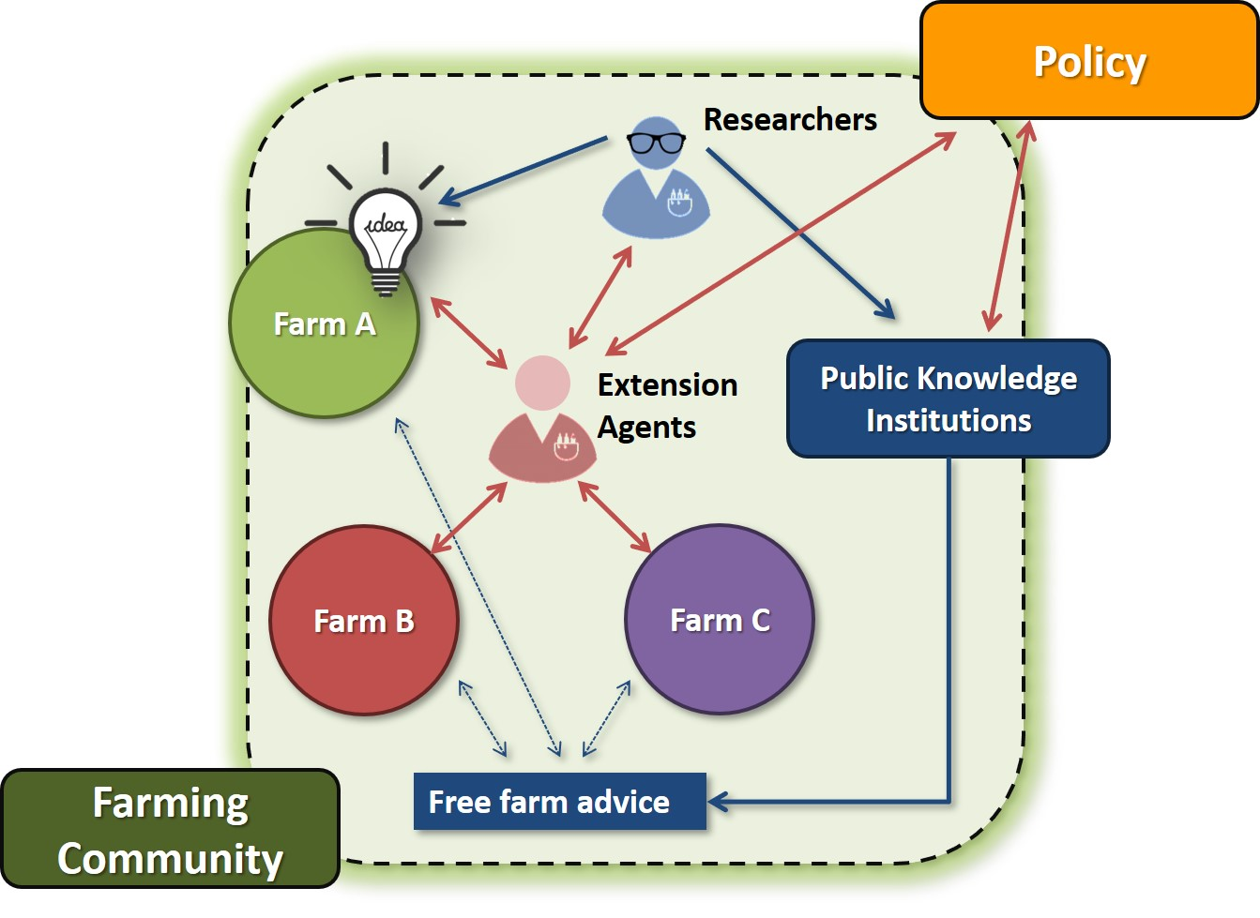
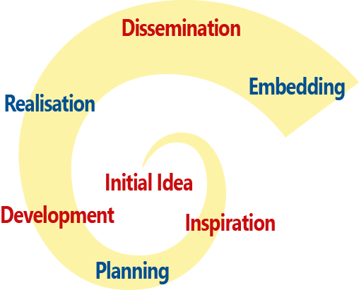
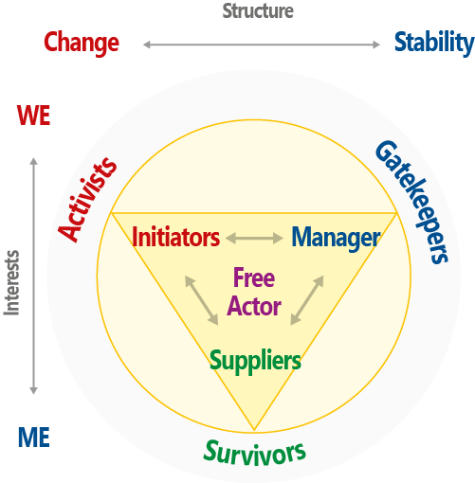
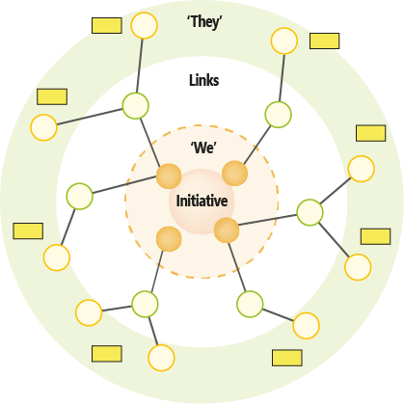
Is my project an ‘interactive innovation’ process?
How do I feed enthusiasm in my network?
When can I call it an innovation?
How can I reach agreement on joint actions?
What is my role?
The energy slips away. What can I do?
What skills do I need for this type of work?
How can I deal with defensive patterns?
What is the i2connect project all about?
What if things become really nasty?
Interactive innovation
Network dynamics
How do I start an interactive innovation process?
How far am I in the process?
What could be the next step?
Advisors
Innovation process
What is my position in the network?
Innovation support agents
How do I create space for co-creation?
How can I stimulate partnership?
Positions and power
Which actors are involved, and at what level?
Which actors need to become involved?
Which steps can be taken to build a network that makes things move?
How can I reflect on what I am doing?
How can my network deal with power issues in the larger structure?
What can be called ‘progress’?
How can I justify my efforts?
More questions
Creating movement
Is this network vital enough to carry on?
Monitoring and reporting

Slide 5
What is an ‘interactive innovation’ process?
What makes training in i2connect special?
What is my role as a trainer?
What skills do I need for this type of trainings?
What is the i2connect project all about?
Training for interactive innovation
What is expected from me as a trainer?
Why is the European Commission doing this?
What support is offered by the project?
What is AKIS?
What is expected from participants in my training?
What is the focus of i2connect in innovation?
How can I make the training attractive for participants?
What can I do to address this in my training?
Trainers
Understand the context of AKIS and EIP
Trainers
Coaches
More questions
Training and coaching in i2connect
What are tools and what are methods?
What tools are available?
Where can I find examples of training programmes?
What methods are available?
What elements should be in the programme?
What theory is available?
Can I bring in my own tools and methods?
Tools for analysis in training and coaching
Where do I find support when needed?
Prepare my training
How do I reflect on what I am experiencing?
How do I guide the participants in reflection?
What reflection is required in i2connect?
What is special in reflection methods in i2connect?
Reflection and peer consultation

Slide 6
What is the i2connect project all about?
Innovate to connect
What is an interactive innovation process?
For what cases is a multi actor innovation process preferable?
And when is it better to apply different approaches?
Why and when interactive innovation?
What aspects appear to be important for managers?
What support do my agents need for this job?
How can I keep my agents accountable for their efforts?
Why is the European Commission promoting this?
Enablers
Managers
What is AKIS?
Managers
Project officers
Policy makers
Why is it often so hard to create space for co-creation?
What makes such processes so different?
What support do projects need to perform best?
How can we keep projects accountable for their expenses?
Understand the context of AKIS and EIP
Project officers
How do I reflect on what I am experiencing?
How do I guide collaborators in reflection?
Why are such processes so different?
What are common limitations in an AKIS ?
What measures are helpful? Examples.
What reflection is required in i2connect?
What is special in reflection methods in i2connect?
Reflection and monitoring
Policy makers

Slide 7
Fuelling competences of advisors in Multi-Actor innovation processes
Multi actor innovation processes
In such processes innovations emerge as a result of the efforts of a variety of actors.
For example: farmers, researchers and other knowledge workers, active citizens, people from commercial enterprises, policy makers, etc..
Operational Groups that are eligible for funding under the EU/EIP programme are supposed to be multi actor innovation projects.
At least farmers and knowledge workers should be part of an Operational Group.
Is multi actor innovation always best? (No)
Competences of advisors
For guiding such processes only technical know-how is not enough. It requires insights in multi actor innovation processes and the dynamics of co-creation in networks.
This includes competences to recognise patterns, and skills to act in accordance with what the actual situation requires.
Learning about processes is different from learning about personal skills, new techniques or transitions in society.
Innovation support agents
The terms advisors and innovation support agents are interchangeable in this portal. The focus is on guiding innovation processes with multiple actors. Not all advisors do so.

Slide 8
Advisors
The i2connect project focusses on advisors in the agri-food sector who facilitate interactive innovation processes.
What are interactive innovation processes?
What makes facilitation in interactive innovation process
so special?
Other terms for professionals performing this work:
Innovation Support Agents
Extension agents / workers
knowledge workers
Facilitators
Change agents
In the European Innovation Partnerships Programme funding is available for ‘Operational Groups’: groups of actors (farmers, researchers, others) who jointly work towards an innovation.
The i2connect project is designed to increase the quality of such groups, by training and coaching advisors who act as facilitators.
The i2connect effort applies to all ‘Multi-Actor Processes’ in which people from different positions in society try to find answers together on ambitions they share.

Slide 9
Trainers and coaches
In the i2connect project trainers design and carry out trainings for innovation support agents in their own language.
Coaching the agents during half a year after the initial training of 3 days belongs to the package.
The aim is to strengthen the skills of the agents for coaching each other in peer-to-peer consultations.

Slide 10
Enablers
Managers
Project officers
Policy makers
Interactive innovation processes are different from projects that are supposed to deliver calculable results.
Enablers
People who influence the conditions for multi actor innovation processes are called ‘enablers’. They create the environment that enables agents to do what is needed.
Managers
People who direct the activities of innovation support agents and other advisors: as head of a service or branch, or as director of an organisation.
Project officers
People in funding agencies to whom project leaders or beneficiaries report.
Policy makers
People involved in setting the rules. Public servants preparing policy documents and rules, and politicians who take decisions about policies.

Slide 11
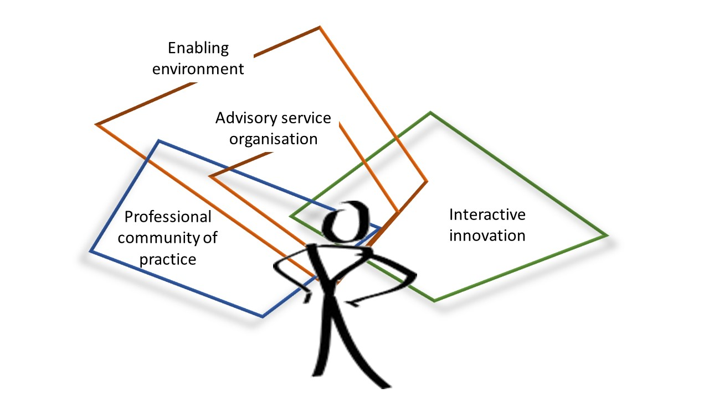
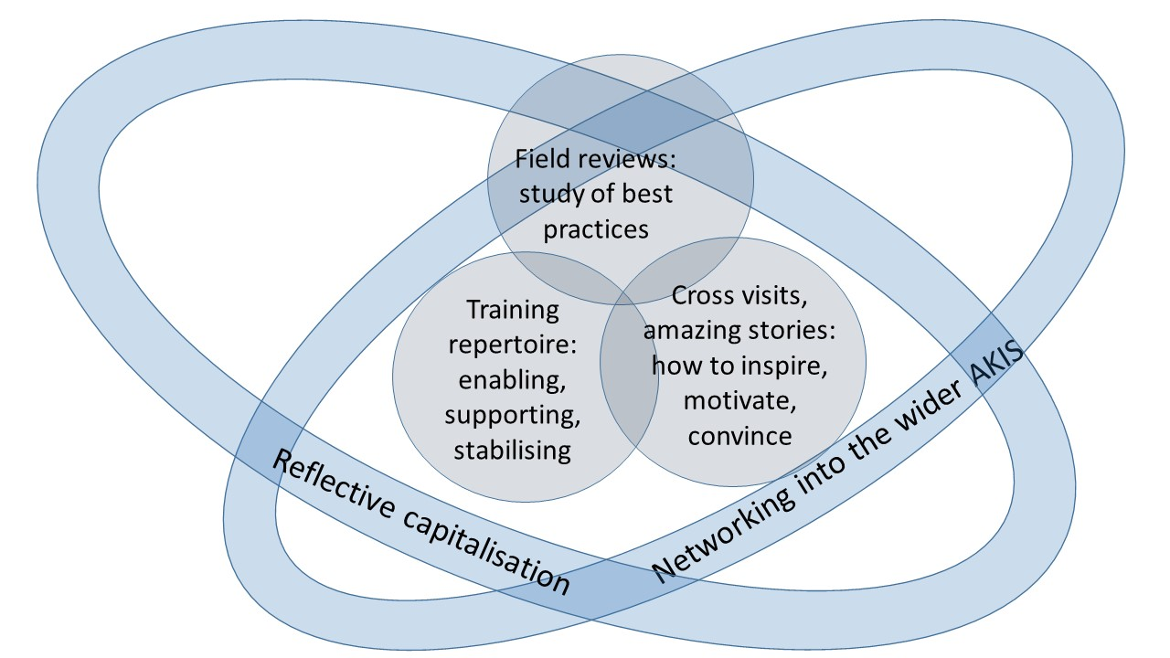
The i2connect project
Key components of the project
Work package 1: Science.
Build further on relevant scientific knowledge and international experiences, and capture what is being learned during the project (reflexive monitoring).
Work package 2: Best practices.
Search for inspiring examples of interactive innovation in Europe.
Work package 3: Methods.
Collect and develop methods for training of advisors, trainers, teachers and enablers.
Work package 4: Training and network.
Provide training and coaching for advisors, trainers, teachers and enablers. Build a professional network for collective learning and improving practices, both at the level of innovating farmers and the enabling environment.
Work package 5: Communication.
Support all partners in the project in communicating with each other and the world outside.
Work package 6: Management.
Facilitate project activities and communicate with the funding agency (European Commission).
Work package 7: Integrity.
Fuelling competences
The project aims to strengthen the capacities of advisors in agriculture and forestry in Europe to guide interactive innovation processes.
Duration
The project started in November 2019 and has a duration of 5 years.
Partners
The consortium is formed by 24 partner organisations from 17 European countries. 12 organisations are connected as ‘third partners’. The three major associations for advisory services, EUFRAS, IALB and SEASN are partners in the project. This means that the project covers practically all Europe.
Source: Grant Agreement

Slide 12
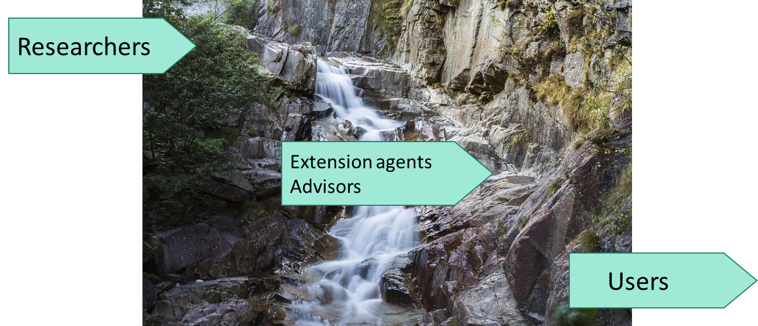
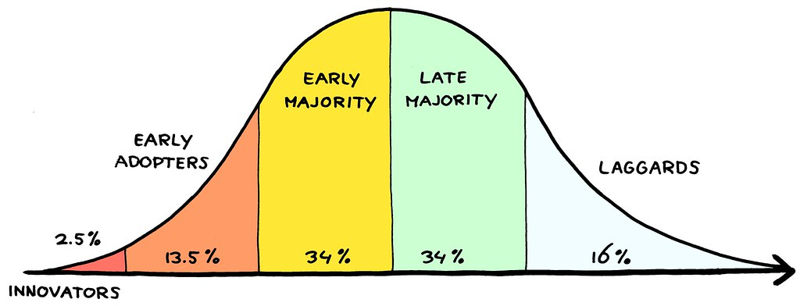
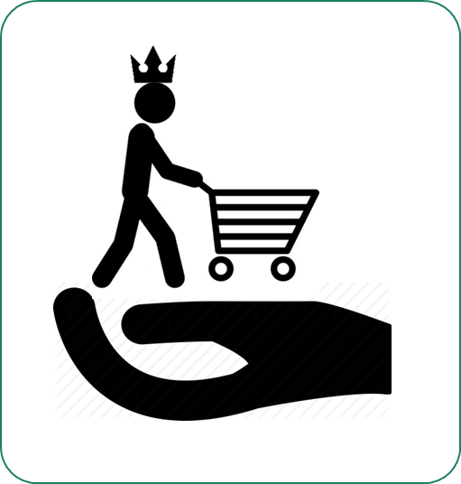
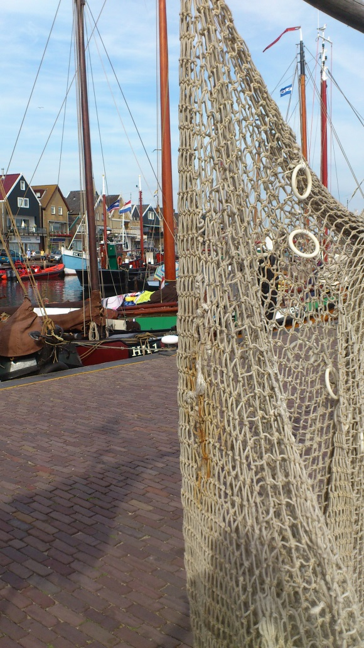
Why AKIS?
A brief history of the concept
1
Transfer of Technology
What is AKIS?
In the decades of recon-struction after WO2, innovation had to be speeded up.
2
Systems Thinking
AKIS means Agricultural Knowledge and Innovation System.
It refers to all actors involved in generating and exchanging knowledge and processes of innovation within a certain system.
Actors can be persons (farmers, advisors, researchers, consumers, citizens, policy makers, retailers, etc.) or institutions (farmers unions or chambers, research institutes, advisory organisations, governments, funding agencies, civil society groups, consumer boards, etc.).
Actors who are related to each other form systems, with capacities that go beyond what each actor can do individually. A food chain is a system, in which suppliers, farmers, advisors, traders, transporters, controllers, retailers and consumers are interconnected.
You can look at local, regional national or global food systems.
You can look at sectoral systems, such as the dairy industry.
Etc.
Innovation systems refer to interrelated actors involved in innovation processes.
Knowledge as different meanings, depending on the worldview someone believes in. Each view has its qualities and limitations.
In the end of the 80ies, systems thinking became popular.
Farmers can have good reasons not to adopt.
The capacity of a system depends on the quality of the connections between its actors: “The wiring”.
Research was supposed to generate knowledge for innovation. Extension should disseminate knowledge to farmers.
Next came the question: why don’t they adopt? Adoption research becomes popular
Knowledge is more than research findings. All individual have their own knowledge, including experience, intuition, beliefs, etc..
“Knowledge is between the ears” and cannot be transferred.
Knowledge should be distinguished from information. The concept of AKIS is born as: Agricultural Knowledge and Information Systems.
3
Market
In the 90ies, neo-liberalism conquers the world. Knowledge becomes a product.
Researchers become producers of knowledge. Extension agents become advisors who act as salesmen op knowledge products.
4
Networks
From the years 10 onwards, the strengths and possibilities of networks become recognised.
Initiators who share ambitions form networks that can develop agency: the capacity to make things move.
Network approaches appear to be effective for creating innovations through interactive processes.
The European Commission launches EIP (2014). It aims at interactive innovation, and offers funding for ‘Operational Groups’ in which farmers, knowledge workers and possibly others work together towards an innovation.
Public extension services are privatised and become commercial enterprises. Public agencies act as clients in the market for knowledge products for the common good.
Knowledge institutions (research institutes, advisory services, consortia) must compete for funds, and are supposed to deliver products according to strict specifications.
The concept of AKIS does not disappear, but is interpreted differently: Agricultural Knowledge and Innovation Systems.
Something is missing: who takes care of the quality of the system (the wiring) if all actors are competing with each other?
Knowledge brokers are introduced to match supply and demand.

Slide 13


Technology Transfer
What is an ‘interactive innovation’ process?
Experts define desired result
In an interactive innovation process the outcome is the result of the efforts of a variety of actors, such as farmers, researchers, and possibly also other persons who bring in relevant knowledge and experience.
Such a process is different from technology transfer, in which the solution is transferred from a source to an end user.
It also differs from a production process, in which the product to be delivered has been defined and specified by the client.
Project
Production process
(market)
Client defines desired result
In interactive innovation processes, the result emerges from co-creation. The knowledge, experience and creativity of people involved are needed to create solutions that cannot be known beforehand.
The challenge of facilitating such processes is to create a ‘biotope’ in which people are willing to join, to learn and to create together.
If this is successful, the outcome is better than anyone could have thought of before.
(Funding agency defines desired result)
Discovery journey
Interactive innovation process
Initiators define shared ambition
What makes facilitation in interactive innovation process
so special?

Slide 14
Interactive innovation emphasises cooperation among various actors, the sharing of knowledge and effective intermediation between actors along the value chains and at different territorial levels.
Key for interactive innovation is that existing (sometimes tacit) knowledge is included whereby end -users and practitioners are not only involved as study objects but their entrepreneurial skills and practical knowledge are used for developing the solution or opportunity, thereby creating co-ownership.
What is interactive innovation?
Multi-actor approach involves all the relevant actors along the entire project; from the participation in the planning of work and experiments, their execution, up until the dissemination of results and possible demonstration phase.
The relevant actors are those that share a complex problem, which requires new knowledge and practice and include actors from different societal sectors such as researchers, entrepreneurs, educators, government workers, NGO representatives as well as farmers/farmer groups, advisors, enterprises, etc.
Interactive innovation is more than a researcher involving some farmers to try out and adjust a new finding, before bringing it to the market.
What more?
Several concepts are frequently being used for indicating what we are talking about. The science team in i2connect has worked out a number of them.
Interactive innovation
Multi Actor Approach
Innovation Network Approach
Professional Organisations and Peer-to-Peer Networks
Learning Organisations
Communities of Practice
Innovation Platforms
The first three concepts are presented here.
The innovation network approach considers innovation to be the result of networks, which can be seen as social processes encouraging the sharing and utilization of knowledge. A network can be defined as a set of formal and informal social relationships between heterogeneous actors that shape collaborative action
Source: Andrea Knierim, Maria Gerster-Bentaya, Fanos Mekonnen Birke,
Sangeun Bae, Tom Kelly (2021): Innovation advisors for interactive innovation process: Conceptual grounds and common understandings.
I2connect deliverable 1.1

Slide 15
The weather is a complex system. Too many factors involved make long term predictions impossible. Recognising patterns allow for short time predictions and to choose options for action (bring umbrella).
An airplane is a complicated system, but when you know how things work, the outcome of your actions is predictable. Analysis and instruction.
Complex
Knowable (Complicated)
Complicated or complex
The Cynefin Framework
Cause and effect coherent in retrospect, do not repeat
Cause and effect separated over time and space
Interactive innovation
Recognise patterns, and develop options to respond
Analysis and instruction
Interactive innovation fits to challenges in complex systems.
Kurz and Snowdon (2003) distinguish four types of systems:
Simple
Complicated (knowable)
Complex
Chaotic
Each system:
Differs fundamentally in nature
Requires a different approach for reaching results
Calls for a different type of management
Technology transfer fits to complicated systems
Interactive innovation fits to complex systems
Scenario planning
Pattern management
Chaos
Simple
No cause-and-effect relation perceivable
Cause and effect relations repeatable and predictable
Act for restoring stability
Develop best practice (recipes, standard procedures)
Crisis management
Process engineering
Disaster strikes unexpectedly: Just do the best you can.
In disaster prone areas you might take precautions for just in case (for example for earthquakes or floods.)
Baking a pancake: relations between cause and effect are known, just follow the recipe.
Social systems are complex
Source: Kurtz, C.F., Snowdon, D.J. (2003): The new dynamics of strategy: Sense-making in a complex and complicated world. IBM Systems Journal (42)3.

Slide 16
What is it?
Space where cooperation is possible = everyone can contribute and release, talk and listen, transform and be transformed…
A systemic dynamic
A goal and a process
What is vital space?
Vital space is a central concept in interactive innovation.
It is the space in which new ideas can emerge from interactions between people.
Where the answers are not known beforehand.
Where there is room for curiosity.
Where difficulties and failures are valuable material to learn from.
It is the space where people feel protected and meaningful. Interactions in the vital space give you energy.
Vital space
is key in interactive innovation
Conditions to allow it?
Readiness / Openness
Time
Shared rules
Facilitation/animation/moderation
Goal = objective (+/- common)
Shared initial interest that federate participants = concern, ambition (challenge, problem…)
Conceptual roots
How to support it in training ?
- Enabling environment (organisation, rules, food, space, openness…)
- Tools to experiment
- self/collective reflection
Source: Synthesis of Christèle Couzy (idele) WP3 – after exchange with Tom Kelly, Linda Sarke (WP1&2), Ruth Moser (WP3), Eelke Wielinga, Alex Koutsouris (WP3&4), Marie Boitelet (WP2&3) 2023-01-24

Slide 17
What is it?
Space where cooperation is possible = everyone can contribute and release, talk and listen, transform and be transformed…
A systemic dynamic
A goal and a process
A systemic dynamic
What will happen in the vital space is fundamentally unpredictable.
Otherwise, the result would not be an innovation.
Yet, there are patters which can be recognised in the dynamics of the system.
This makes it possible to intervene according to what the situation is demanding.
Interactive innovation methodology is what is needed in complex systems.
This contrasts with the way to act in complicated systems, which calls for analysis and instruction.
What is vital space?
A goal and a process
Partners in interactive innovation share an ambition.
They might formulate this as a goal.
However, the result cannot be known precisely.
It might be better than anyone had thought of, because it is the result of contributions from all and in addition the synergy which grows in the process.
Ultimately, even more important than the concrete outputs is the growing capacity of the network to find solutions to new challenges: responsive capacity.
The process is a goal in itself.
Vital space is a central concept in interactive innovation.
It is the space in which new ideas can emerge from interactions between people.
Where the answers are not known beforehand.
Where there is room for curiosity.
Where difficulties and failures are valuable material to learn from.
It is the space where you feel safe and meaningful. Interactions in the vital space give you energy.
Vital space
is key in interactive innovation
See: the Cynefin framework
Back to vital space

Slide 18
Things you can do to stimulate vital space:
Basically, it is all about creating conditions in which connections are made and become stronger.
According to the Circle of Coherence,
there are three pathways to follow:
[1] Feed connection
Balance between give and take, challenge, structure are essential elements of vital space you can stimulate. Once there is peace in these three patterns there will be space for real curious dialogue.
[2] Make defence less needed
We all balance between collective space which might become vital and our own individual space which we protect with our defensive mechanisms. Specific attention for what people need to open doors is helpful.
[3] Stop destructive patterns
When defensive patterns have escalated into destruction, communication alone is not enough. Powerful interventions will be needed to bring people back in positions where they need to communicate again.
What is vital space?
Vital space is a central concept in interactive innovation.
It is the space in which new ideas can emerge from interactions between people.
Where the answers are not known beforehand.
Where there is room for curiosity.
Where difficulties and failures are valuable material to learn from.
It is the space where people feel protected and meaningful. Interactions in the vital space give you energy.
Vital space
is key in interactive innovation
Conditions to allow it?
Readiness / Openness
Time
Shared rules
Facilitation/animation/moderation
Goal = objective (+/- common)
Shared initial interest that federate participants = concern, ambition (challenge, problem…)
By-products:
If someone says: “Trust me”, you probably trust him a bit less.
Trust cannot be imposed or bought, nor is it an agreement. It only emerges if there is connection. The same is true for vital space.
Vital space is a by-product of a process, which cannot be managed directly. The same is true for spontaneity, creativity, happiness, love: in short, the things that matter most in life.
Back to vital space
Vital space is not equal to trust:
Trust is the confidence that things will be alright in the end. Trusting someone means having confidence that (s)he will not abuse your openness.
However, you can trust someone too much, becoming vulnerable and powerless.
In vital space there is also challenge and a degree of discipline.

Slide 19
Back to vital space
What is vital space?
Vital space is a central concept in interactive innovation.
It is the space in which new ideas can emerge from interactions between people.
Where the answers are not known beforehand.
Where there is room for curiosity.
Where difficulties and failures are valuable material to learn from.
It is the space where people feel protected and meaningful. Interactions in the vital space give you energy.
Vital space
is key in interactive innovation
Learn to recognise patterns
Experiment with options for intervention.
Choose what fits you best.
Take your intuition seriously.
We know much more than we think.
We feel where things need attention and what needs to be done. Emotion is our indicator, and energy makes it concrete.
It helps to give words to what we somehow already know.
How to support it in training ?
- Enabling environment (organisation, rules, food, space, openness…)
- Tools to experiment
- self/collective reflection

Slide 20
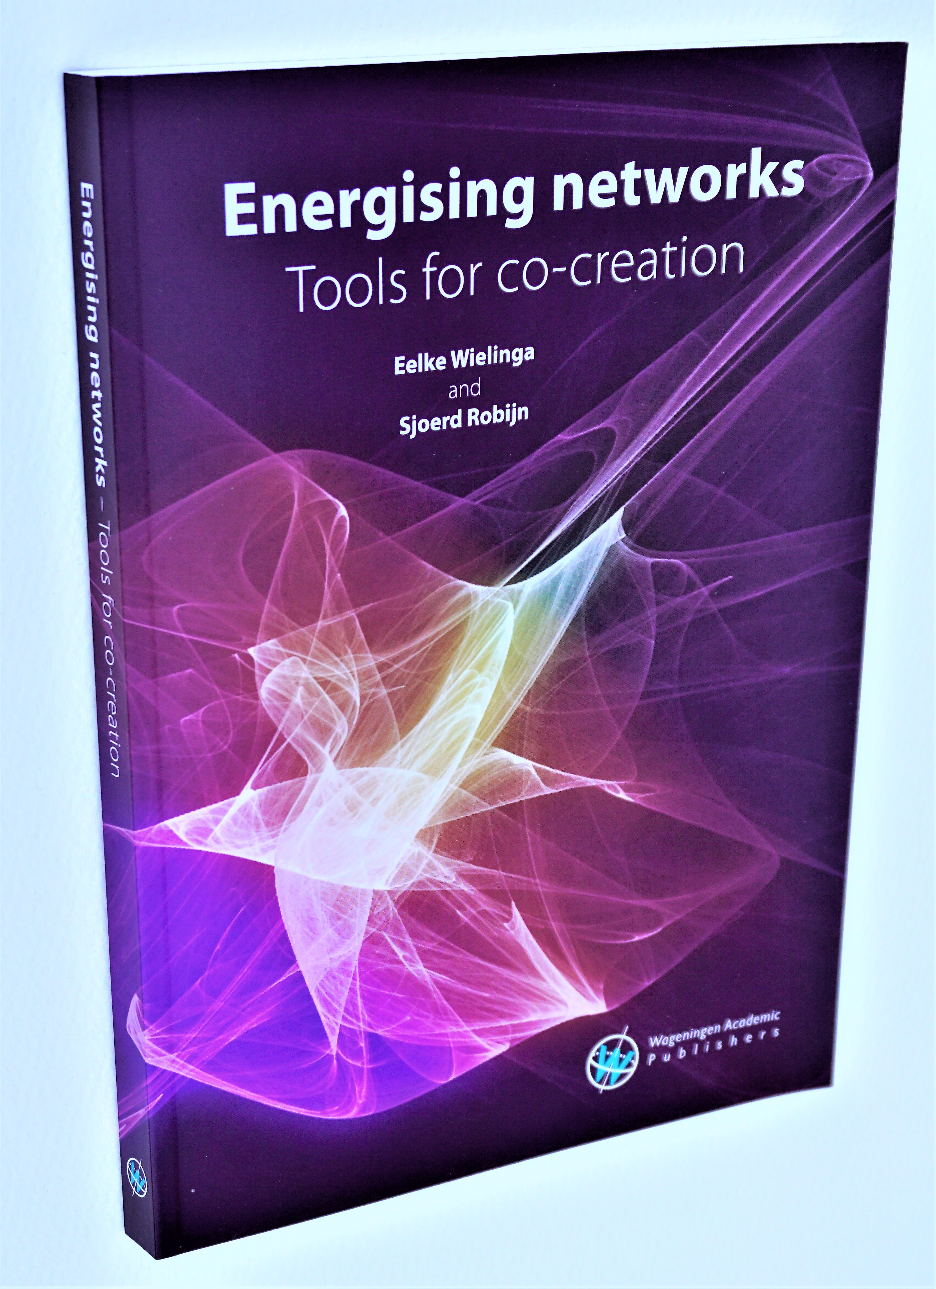
First publication of Vital Space in:
Wielinga, H.E. (2001). “Networks as Living Tissue: a study on knowledge, leadership and the role of government in Dutch agriculture since 1945” PhD thesis, Wageningen University.
What is vital space?
Basic assumptions:
The most important things in life cannot be constructed (trust, creativity, love).
They can emerge if there is connection.
Connection is the basis of all living processes.
All living entities have an energy management system.
Human networks are living systems, and part of the global eco-system.
Focus on energy between people provide insights to influence connections.
A well-connected network is responsive: capable of finding new solutions in a changing environment.
People always balance between connecting and self-defence.
Intervention is effective if it takes away reasons for self-defence.
Vital space is a central concept in interactive innovation.
It is the space in which new ideas can emerge from interactions between people.
Where the answers are not known beforehand.
Where there is room for curiosity.
Where difficulties and failures are valuable material to learn from.
It is the space where people feel protected and meaningful. Interactions in the vital space give you energy.
Vital space
is key in interactive innovation
Conceptual roots
More recent:
Back to vital space
Wielinga, H.E., Robijn, S. (2020):
Energising Networks,
tools for co-creation.
Wageningen Academic Publishers.
Theory
Tools
Philosophy

Slide 21
Typology of advisor’s roles
In interactive innovation processes, advisors assist groups with various actors to jointly create new solutions.
How does this role relate to the tasks and activities that are commonly attributed to different titles that are in use for innovation support agents?
The science team in i2connect made a typology.
Source: Andrea Knierim, Maria Gerster-Bentaya, Fanos Mekonnen Birke,
Sangeun Bae, Tom Kelly (2021): Innovation advisors for interactive innovation process: Conceptual grounds and common understandings. I2connect deliverable 1.1
Based on Koutsuris (2018), Leeuwis (2004), Klerkx and Leeuwis (2008), Hoffmann et al. (2009)

Slide 22
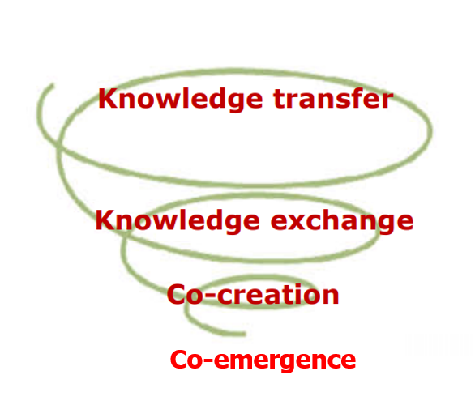
Instruct about how to do things
Share knowledge and experience
Find new solutions together
When is interactive innovation preferable?
Develop capacity for jointly identifying challenges and solving them
It depends on the degree of agreement between actors involved on:
The definition of the problem
The desired target to be reached
The solution to be implemented
The way it should be implemented
If there is a shared ambition (agreement on problem and target) but the solution and the way to find such a solution cannot be decided beforehand, a process of co-creation is needed.
If there no agreement on what is at stake or where to go, a process of co-emergence is needed, in which actors become capable of identifying challenges and solving them: the capacity to respond.
These two are the domain of interactive innovation.
Knowledge generation and dissemination | Actors involved agree on: |  |  |  | In other words…
 | Problem | Target | Solution | Imple-menta-tion
Knowledge transfer | Yes | Yes | Yes | Yes | Info transfer for known problems, solutions and implementation
Knowledge exchange | Yes | Yes | Yes | No | Sharing knowledge, working out implementation together
Co-Creation | Yes | Yes | No | No | Joint search for solutions and implementation, interdisciplinary
Co-Emergence | No | No | No | No | Creating a participatory basis for Problem identification and solutions
Sources:
Ryser (Ulrich) 2021: Presentation in EUFRAS General assembly March 2021
EU SCAR AKIS (2019), Preparing for Future AKIS in Europe. Brussels, European Commission.
TRAME (2016) Faire émerger vos projets – l’art de faire éclore des projets agro-écologiques, Paris.

Slide 23


Levels of learning in society
And the focus of i2connect
Transition
Regime change
10 – 15 years
In innovation, different levels of learning can be distinguished.
Transition is a change of regime, with different goals, rules and policies.
Technology development means finding new techniques, practices and ways to organise things.
The network approach focusses on the quality of the relations in the system: the capacity of networks to respond to challenges.
Personal growth means improving personal skills and awareness.
Technology Development
Innovation: new practices, techniques
3 – 10 years
Example: from growth and profit towards sustainability
Conducive environment
Management, Funding
Doing things better
Doing better things
Network Approach
Co-creative processes
This is the focus of
Facilitation
Network Dynamics
Create agency, for responding to challenges
Create willingness to learn and to create together
Personal Growth
Communication skills, awareness
Individual effectiveness
Four layers of learning in societal change

Slide 24
Project:
Discovery journey:
What makes facilitating in interactive innovation processes special?
An interactive innovation process is unlike project implementation for delivering a specified result.
Such processes are more like discovery journeys. The explorers have a reason to embark. They share an ambition, which gives them a direction to go.
But it is unknown what they will encounter underway. Which support will they need, and how do they acquire it? What surprises will they encounter, and how will they cope with them? Where will the journey end? If this was known beforehand, nothing new would be found.
This gives a different dynamic to such processes. Facilitators need skills to navigate in unknown areas.
Recognise patterns
Act upon what the situation requires
The task of a facilitator is to create vital space in which actors involved are willing to collaborate and develop the capacity to find solutions together in co-creation.
Success defined by client
Product is central
Structure leads
Focus on tasks and agreements
Rules, procedures and sanctions
Hierarchy
Supervision
Path is mapped out beforehand
Contractors accountable to client (funding agency)
Support from higher management
Reporting on results with indicators
Success defined by initiators
Ambition is central
Opportunities and creativity are leading
Focus on relationships and energy
Space to learn by trial and error
Equality and voluntariness
Mentorship and peer coaching
Path is discovered
Facilitator accountable to network
Nourishing relationships
Communicating on process by story telling
This is the focus of

Slide 25


Reflection among peers
Self-reflection
Addressing a professional network
Lifelong learning
Reflection
Learning
Personal development
What competences are needed?
Being an advisor is a demanding job. Even more so if you are supposed to guide innovation processes with multiple actors in an interactive way.
What competences can we think of?
Understanding social context
Understanding AKIS
Technical know-how
Communication skills
Management
Organisation
content
methods
organisation
Basic disposition and attitude
Further reading: Gerster-Bentaya, M., Hoffmann, V., Christinck, A., & Lemma, M. (2009). Handbook: Rural Extension. (Volume 3) Training Concepts and Tools. https://doi.org/10.16309/j.cnki.issn.1007-1776.2003.03.004
Self-awareness
Sensitivity
Personal drive
Reliability
Understanding innovation processes
Energy in social relations
Co-creation
Mediation

Slide 26
❶
What competences are needed?
Basic disposition and attitude (1)
These attributes form the foundation of the advisor’s competence. The clusters of competencies provide answers to the questions: How well do you know yourself? How connected are you to your own drive? How well are you connected to others?
❷
Content competence (2)
The second theme of competencies is about understanding the context the advisor is working in, as well as several basic requirements in terms of education and technical skills.
❸
Methodological competence (3)
The competencies under methodological competence are specifically related to facilitating co-creation and innovation processes.
❹
Managerial and organisational competence (4)
This theme comprises the practical skills needed to organise- , implement-and follow-up on projects.
Reflection and personal development (5)
Advisors should constantly look to improve the quality of their work. This implies planning moments of reflection, as well as seeking opportunities for education.
❺
Notes:
Questions:
What does the profile of an innovation support advisor look like?
What are essential skills and attributes one must possess to facilitate interactive innovation processes?
Follow-up questions?
How can one develop these competencies? / How can these competencies be trained?
How can we assess if someone possesses a certain competency?
Do we have to find all these skills and attributes in one person?

Slide 27
Only one training?
Some partner organisations send trainers on their own account. This is possible and they are welcome.
No. We hope you will continue offering trainings, while remaining part of the i2c family.
There is a limited budget available for getting started.
We assume that the approaches, your professionality and your enthusiasm will make it sufficiently interesting for managers and policy makers to incorporate it in regional and national programmes for innovation support.
Training and coaching in i2connect
At the end of the i2connect project period 50 trainers will have been trained.
As a i2connect trainer you will design and carry out trainings for innovation support agents.
1
You are part of the trainers pool: a community in which you exchange experiences with colleagues, consult others and advise others.
You work together in duo’s. In principle you participate in the initial training together.
Task 3.6 in i2connect is responsible of organising the trainers trainings (Train-The-Trainer: TTT).
Contributors are (amongst other) experienced trainers from the CECRA16 module on innovation support (Pablo Asensio and Eelke Wielinga), Agridea (Niels Rump) and Idèle (Christèle Couzy). Also former TTT participants join the preparation team.
2
In the initial training you make acquaintance with available approaches and tools. You apply them in exercises and coaching sessions. And you start planning your own training.
Who organises this trainers training?
How do I apply?
3
Back home you organise a training for advisors. In principle this is a face-to-face training of three days in your own language.
Do we have to follow a standardised programme?
How do we prepare our training?
1> Contact your manager
2> Write to Gwénaëlle Fontaine (until August 2021: Ruth Moser)
gwenaelle.fontaine@agridea.ch
Ruth.Moser@agridea.ch
4
This training is followed by peer-to-peer coaching of six months. You organise and facilitate this.
Tools for peer-to-peer coaching?
5
No. You can give your own professional and cultural flavour to the training you will organise.
However, we expect from you that you communicate with us about your plans and how they work out.
You will participate in the coaching within the trainers pool, in which such issues can be discussed.
You select two trainees from your training to participate in a cross visit. This visit takes place withing the six month coaching period.
What is an i2connect cross visit?
6
In exceptional cases you can help a participant to apply for a pilot project within i2connect.
What is an i2connect pilot project?

Slide 28
Learning by doing
You can’t learn how to swim by reading a book about it. Training is creating experiences to learn from.
This also applies to the Train-The-Trainer training (TTT).
What is my job as a trainer?
Bring inspiration
Working together for creating results can be very satisfactory, when you know how to do it.
Practice what you preach
What we expect our trainees to do in their innovation groups, we should apply ourself as well. The TTT is full of opportunities to increase awareness on how we do things.
Stimulate advisors for (joint) reflection
When advisors take time to reflect on what they are doing, preferably together with peers, the quality of their work will increase dramatically.
Everything is material to learn from
The interaction processes we talk about also occur within the training group. The strongest learning experiences are those you experience yourself.
Equip advisors for (joint) reflection
Tools and methods are helpful to make reflection more beneficial.
Coach advisors on their job
Questions will arise after the training when trainees are back on the job and try to apply what they learnt.
Real life cases
As much as possible, real-life cases will be used for analysis. Please share interesting cases you hear about from your trainees.
Assist the i2c community in professionalising
Sharing questions, experiences and findings in the i2connect makes the whole i2connect community grow.

Slide 29
Diagnostic tools have been designed to reflect on ongoing interactive processes: “Where are we now?”
“And what could be my next step?”
Training Contents
Mindset
Trust in the capacities of participants
Their experience is valuable
All opinions matter
Curiosity instead of judgements
The Best Way is unknown
“Yes and..”, instead of “Yes but…”
Many colours instead of black and white
Diagnostic Tools
Warm and Cold Communication
Spiral of Innovations (Initiatives)
Network Analysis
Eco-Analysis
Circle of Coherence
Triangle of Co-Creation
Contract Triangle
What are i2connect trainings about?
The training aims at fuelling competences for guiding interactive innovation processes. The most effective way to learn is to experience and to reflect on what is happening: learning by doing.
It is useful to distinguish different aspects to be addressed:
mindset
posture
diagnostic tools
participatory tools
Posture
Be aware of 3 dimensions that always play a role in group dynamics: Action, process and relation.
If something takes energy, there is something to learn. Embrace it.
‘What can we make possible together’, instead of ‘I know what is good for you’.
Be aware of your favourite role: animator, facilitator, moderator.
Participatory Tools
Energisers
Fishbowl
World Café
Process design
Peer-to-Peer Consultation
Xx
Xx
Process
Support co-creative processes
Mobilise brain and heart involvement
(emotions, body movement)
Action
Relation
Participatory tools help to stimulate active involvement in trainings and meetings.
Courtesy: Idèle, France: Christèle Couzy

Slide 30
Refrain from judgements
You might be surprised about what others say or do. Maybe you would do it in a different way. By expressing this in a judgement (“that is wrong, not very clever, etc..” you put yourself above the other. This creates unsafety.
Remember that differences are essential to learn from. Stay curious for what makes the other say or do so.
Communication guidelines
Create a biotope for learning
As a trainer, you create the conditions in which people feel free to share, to learn and to become creative. A biotope for co-creation.
Speak for yourself
When you observe something, wish something, or want to express an opinion: speak for yourself.
People often speak in the ‘we’ form. It might feel safer. But unconsciously it is also an act to gain power, which might provoke power games.
Some behavioural guidelines are helpful
One way to stimulate such conditions is to introduce a few guidelines for the way you communicate with each other.
Xxx
Yyy
Use incidents to learn from
Not everyone will immediately behave accordingly. Use incidents when people do not follow the guidelines for learning: signal them, and discuss the effects.
Xxx
Yyy

Slide 31
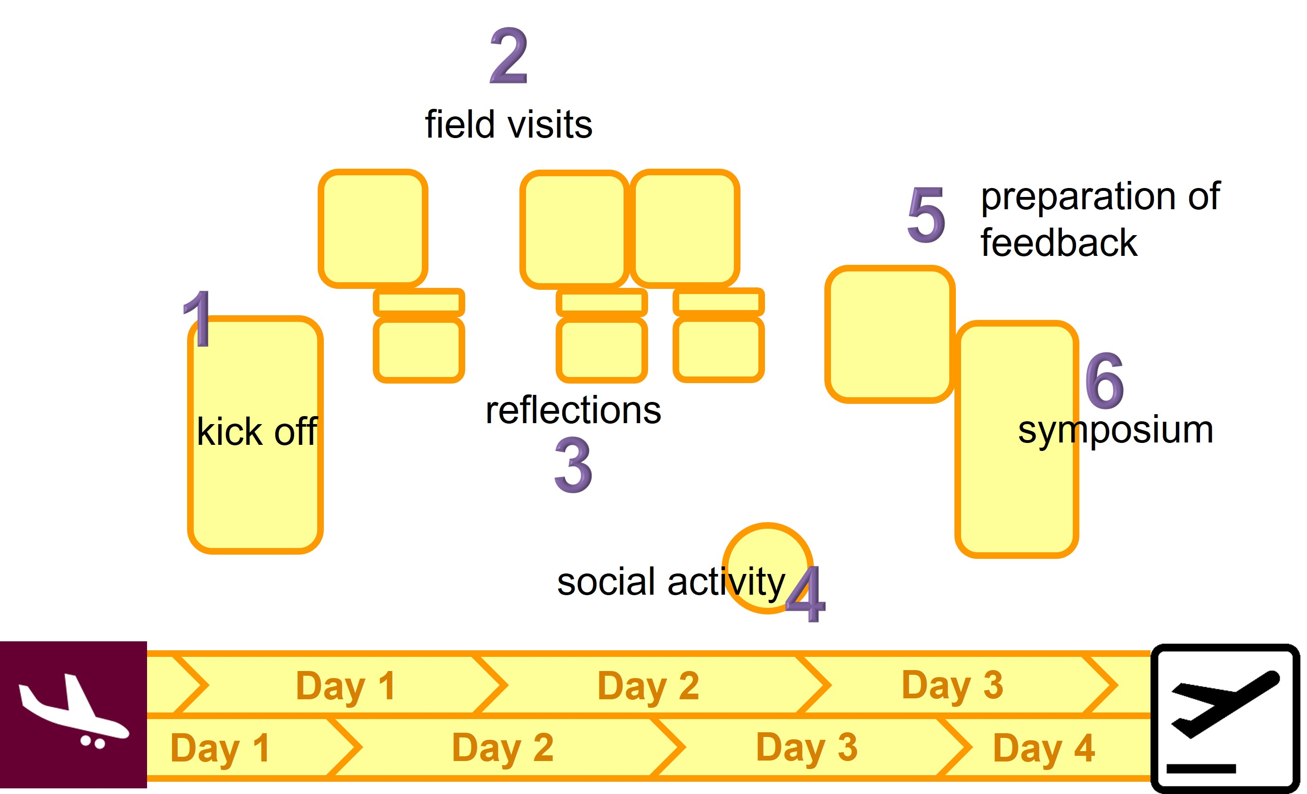
What will happen during a cross visit?
Visitors in the lead: As experts from abroad, you explore one or more cases where interactive innovation is taking place (or has taken place). You are asking the questions, in order to understand what has happened.
The host prepares the case. Every cross visit is hosted by an i2connect partner organisation. This host selects the case, approaches key actors for their collaboration, and organises the visits (including the logistics).
The key actors are informed about the nature of the CV. They know that your questions are leading, rather than their own standard presentations.
Cross visits in i2connect
An opportunity to look beyond borders
The cross visits in the i2connect project are opportunities for selected advisors to go abroad, to meet colleagues from elsewhere, and to jointly study cases of interactive innovation in a certain area in Europe.
Who can join?
From every i2connect training two participants can join a cross visit, preferably within half a year after the training. Participants must be able to communicate in English, since this is the working language during the training. The trainers decide who will go.
What is expected from the participants?
The two participants from each training actively contribute to the analysis of the cases they visit during the cross visits. After their return, they share their experiences with their peer group that was created during the training.
Duration, number of participants and place
A cross visit takes 3 – 4 days.
10 participants can join a cross visit. One or two trainers will act as facilitators.
The first CV has taken place in Slovenia in March 2022.
Further inquiries: Igor Hrovatic. igor.hrovatic@kgzs.si

Slide 32
Pilot projects in i2connect
An opportunity to try out something new
Some advisors, participating in a training, might be involved in a promising initiative for interactive innovation, but have difficulties in finding the funds to support it. These advisors can apply for support from i2connect.
Contribute to learning within i2connect
The i2connect project offers opportunities for such cases if they meet the following criteria:
A
B
C

Slide 33
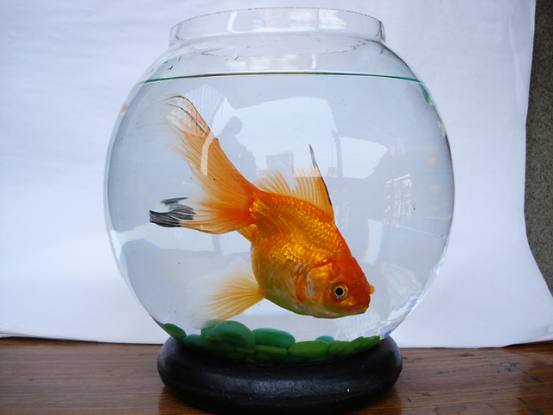
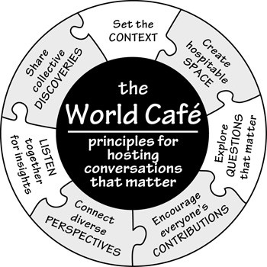


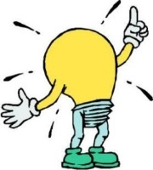

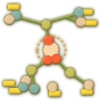
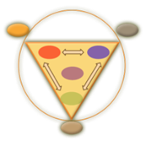

Methods for training
Discussion techniques, training methods and diagnosis
Facilitating group discussions
Many methods can be found on internet for facilitating group discussions. A few easy to use methods are briefly summarised here.
Training facilitating skills
Training methods aim to increase awareness of trainees of what is happening in interpersonal communication, and to strengthen their self confidence in facilitation activities. Such methods provide opportunities to practice and to receive feedback.
A wide range of such training methods can be found on internet as well. A few basic exercises are explained here.
Energizers
Energizers are short exercises that are helpful to focus on what is happening here and now in the training session. They stimulate the physical energy flow in body and mind.
Diagnosing patterns in processes of change
The tools for diagnosis take a wider perspective. They aim to inspire change agents in influencing a movement between multiple actors in a process of change. Which relationships call for attention? And what are possible interventions?

Slide 34
The Double Diamond
Discussion technique
Separate problem space from solutions space
De double diamond method is helpful to stay focussed in a group discussion, and to work systematically towards possible solutions to a problem.
A common pitfall in many discussions is that participants are so eager to jump into solutions that a good assessment of the problem is not being made.
Following the Double Diamond technique you first focus on a proper understanding of the problem. Once there is agreement on a clear understanding of what is at stake, the second part of the discussion focusses on possible solutions.
In each section of the discussion, you first let the discussion diverge until the ‘crunch zone’: a stage in which different views and opinions might compete with each other. Then you converge towards a common understanding of the problem (first diamond) or solution (second diamond).
Sometimes in the second diamond new insight appears for which it is necessary to go back to the first one. Then it is important to clearly mark this and get agreement of the group for doing so.
Problem space
Solution space
Explore
Concentrate
Develop ideas
Develop concrete solutions
Crunch zone
Crunch zone
Courtesy: Ruth Moser 2022
References
Sam Kaner, 2014: Facilitator’s Guide to Participatory Decision-Making Ideo.org, 2015: The Field Guide to Human-Centered Design

Slide 35
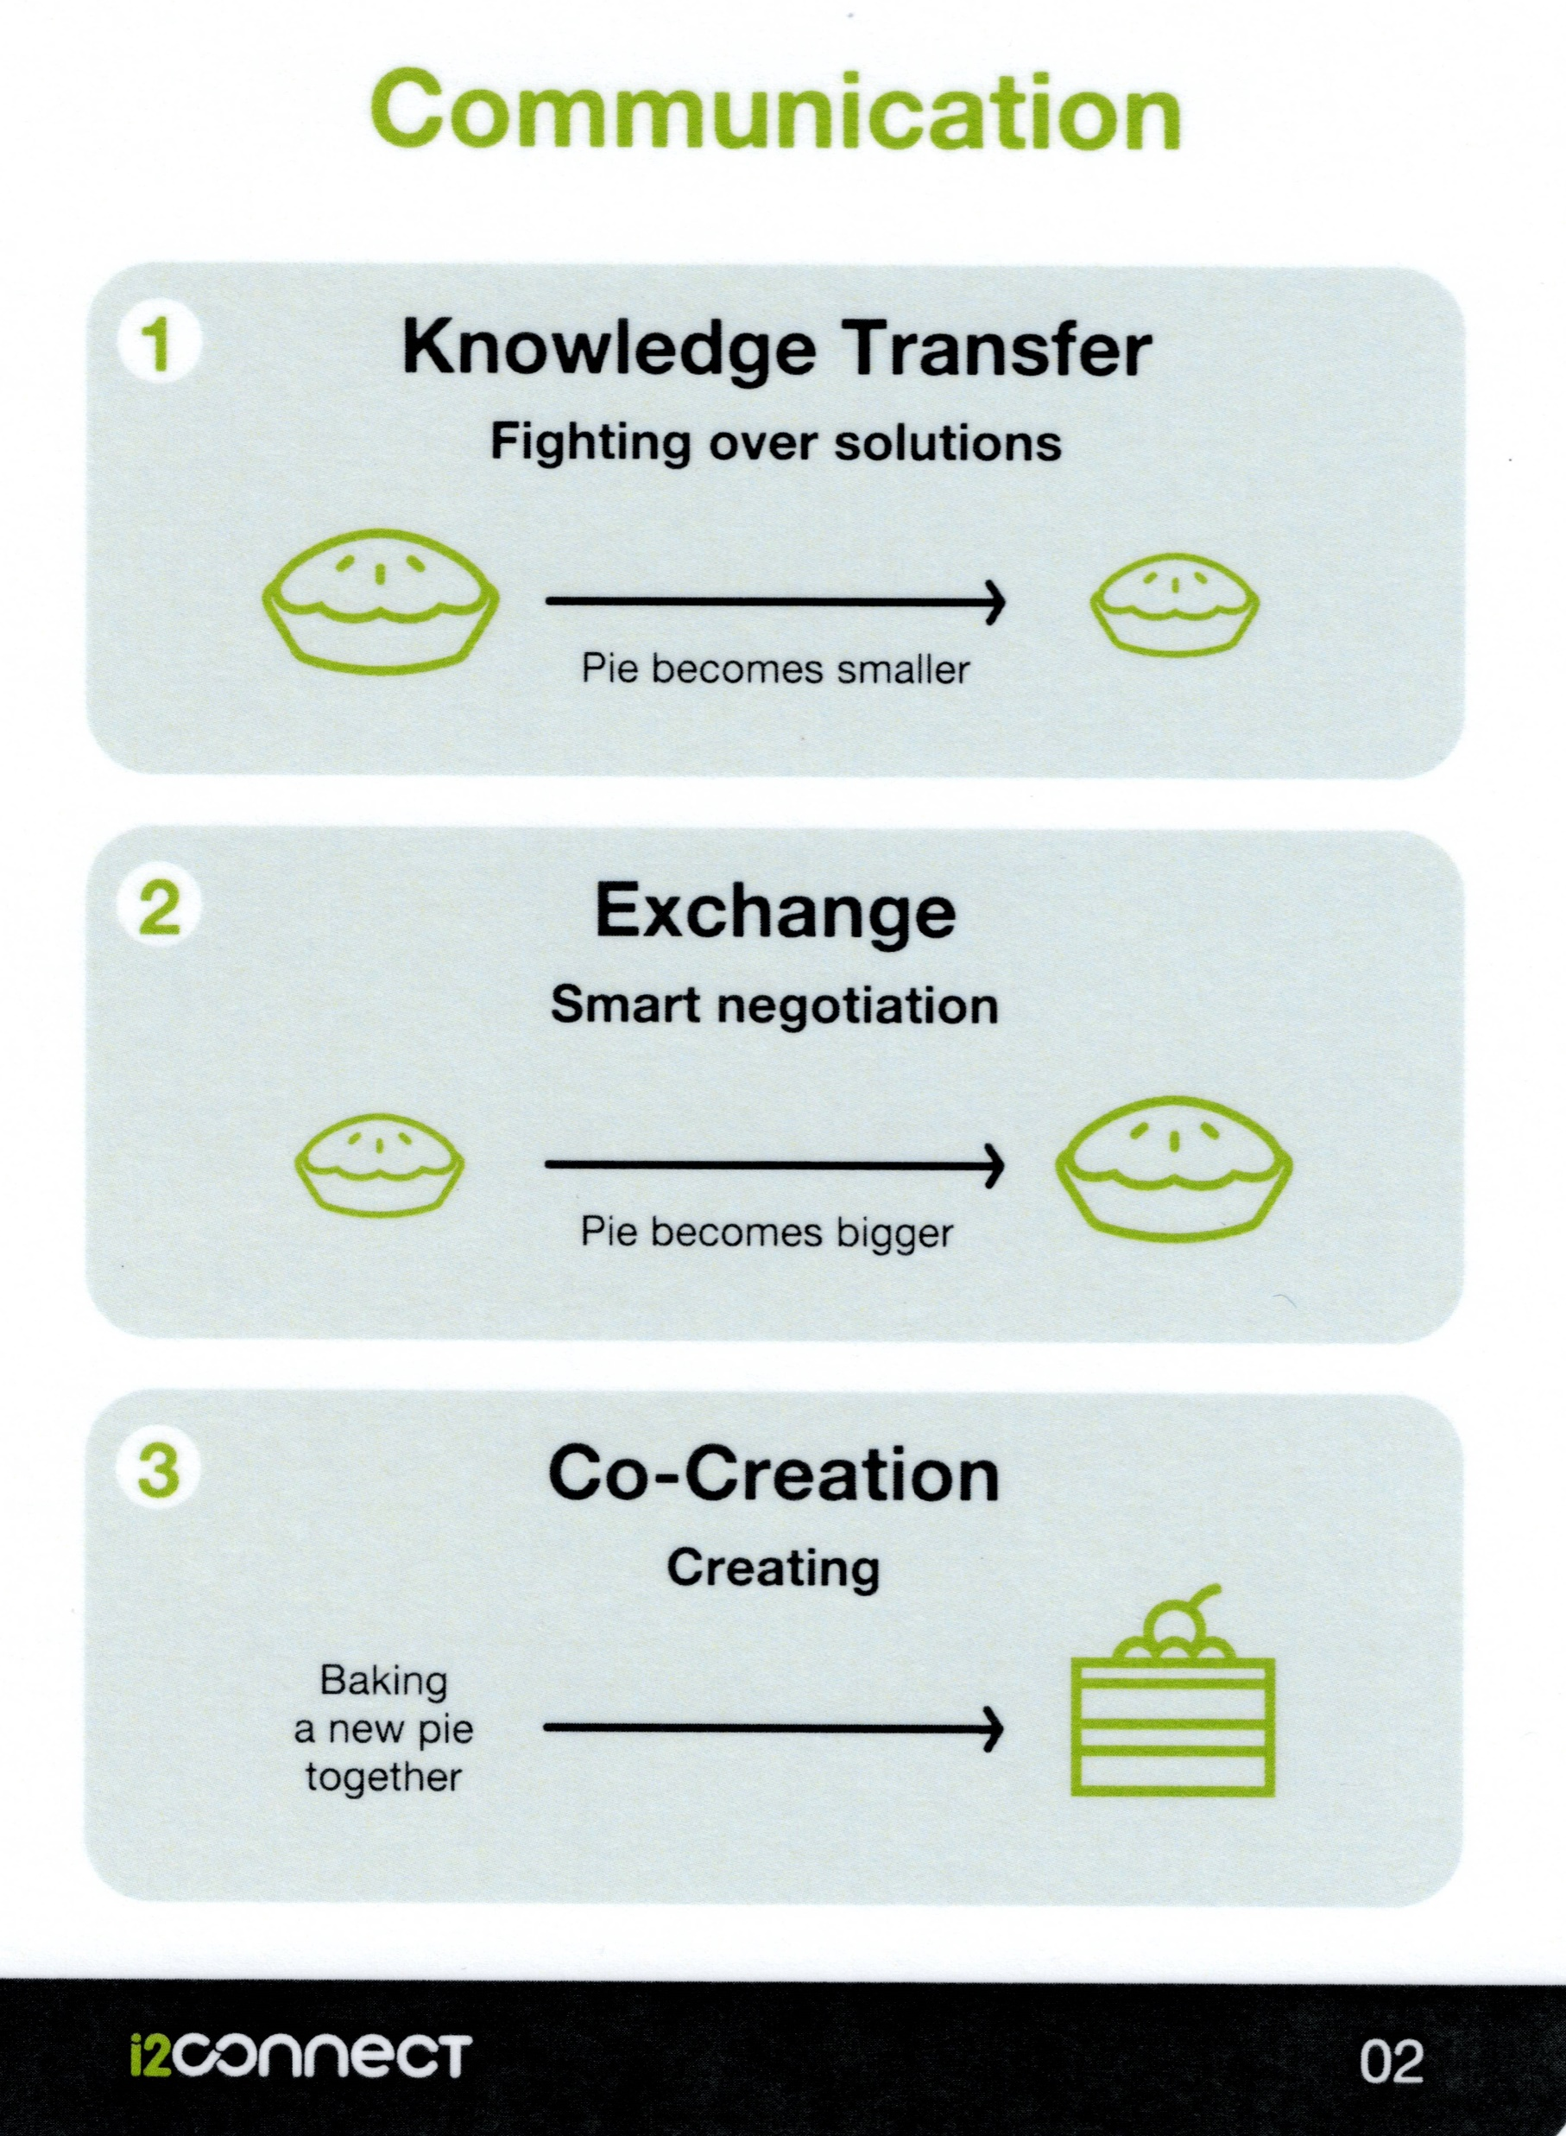
Many people are willing to change,
but few want to be changed.
ASSUMPTION
It is useful to distinguish different communication approaches
Apply if: the message is precisely what the others are looking for.
Risk: You meet resistance, because people feel pushed into a direction they do not want.
This can result in fighting over solutions, limiting the options for satisfactory outcomes.
Each approach has its value. It is important to know which approach fits into which situation.
Transfer: The desired outcome is fixed.
You are successful if others understand and do what you wish them to do.
Apply if: you cannot expect others to join you unless you offer them something in return.
Risk: You cannot reach all your targets.
Smart negotiation: When both parties know more about each others wishes and interests, more possibilities become visible for making win-win deals.
Exchange: The outcome is the result of negotiations.
You want something, but others want something in return for their collaboration.
Co-creation: The outcome is a surprise.
You have a reason to seek allies. You share an ambition for which you embark on the discovery journey. Where the journey will lead to cannot be known at the start.
Apply if: you need allies to get things done.
Key question: “What can we make possible if we would pool our resources?”
Focus on ambitions you share, rather than the outcome you have in mind. Co-creation can lead to results that are better than you could have imagined beforehand.

Slide 36
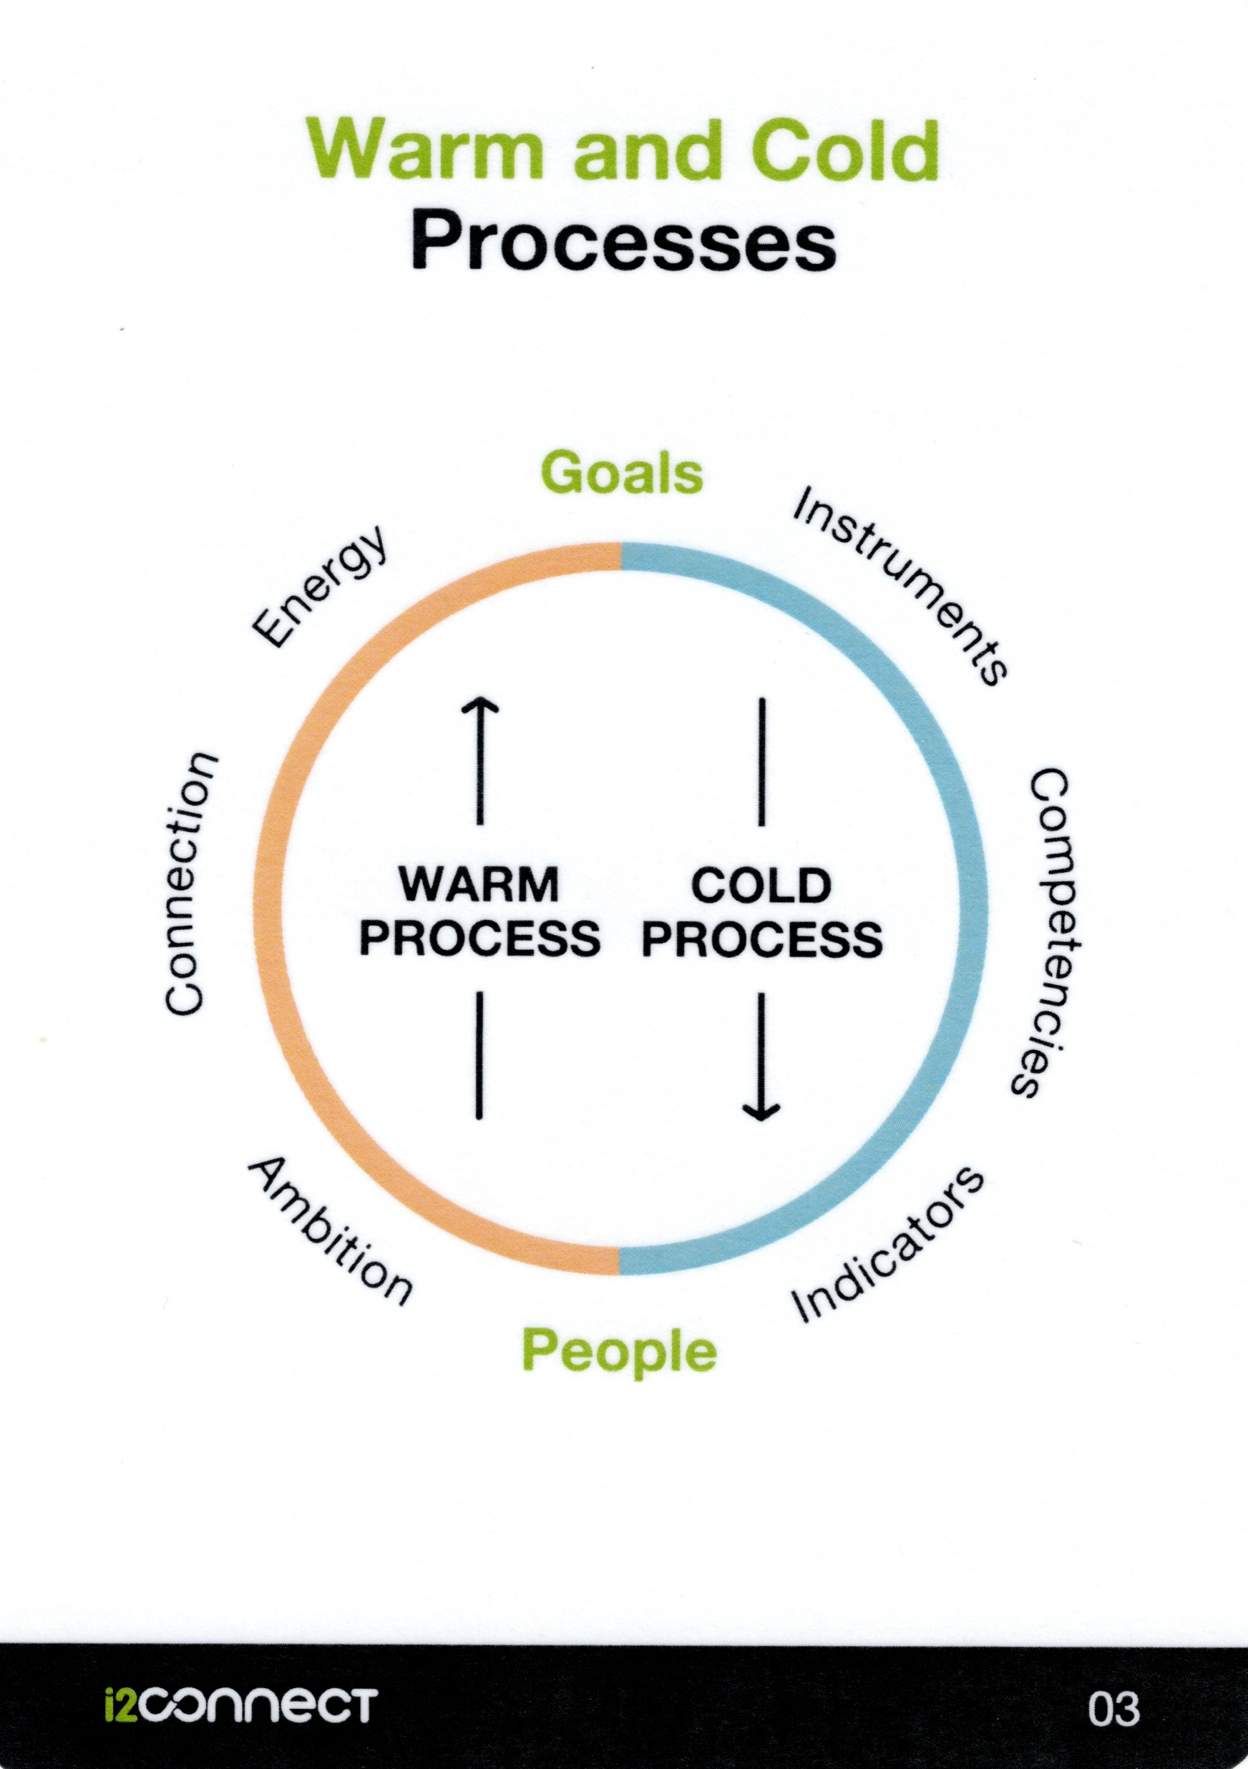
ASSUMPTION
Networks around initiatives differ from projects of organisations.
The people who find each other in something they want to achieve is called the warm network.
Such a network is always informal, and it can cross the borders of teams, institutions or cultural groups.
Projects and organisations have goals and targets. In initiative-based networks people are connected through ambitions they share.
Managers and project leaders assign tasks to employees. In networks people drop out when they run out of energy.
ASSUMPTION
A warm network is the driving force for movement and change.
ASSUMPTION
It is useful to distinguish the warm process from the cold process.
Operational questions:
Do you follow your job or your ambition? Are you performing a task to fulfil, or do you believe in what you are doing and use the space you have to work on it?
Who is part of your warm network? With whom do you share your ambition? Who are your allies?
In which relations could you invest in order to make your warm network stronger and more supportive?
The cold process is about who does what, when, how, and with what instruments and competences. It is also about being accountable to others.
The warm process is about people with ambitions. When they connect, this releases energy because it feeds the hope that together they can do more.
Both processes need each other, like the flow in the river needs a bedding. But if the warm process is overlooked, the cold process leads to nothing.
Further reading: Wielinga and Robijn 2020: Energising Networks p.81

Slide 37
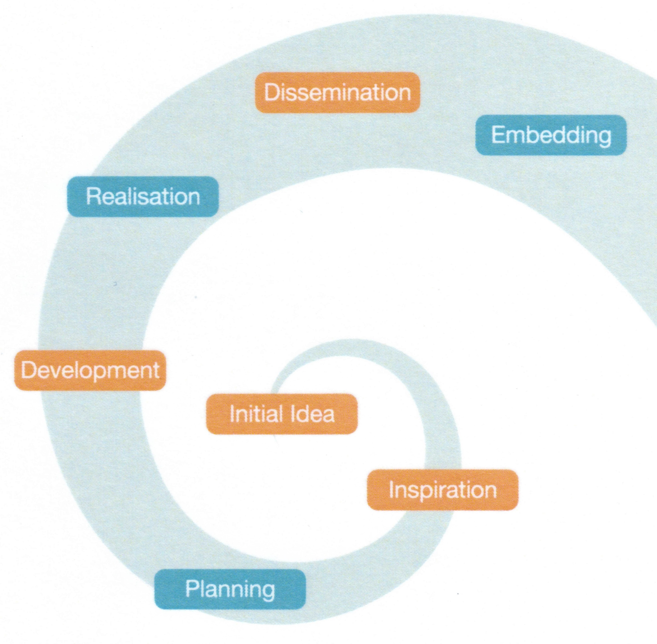
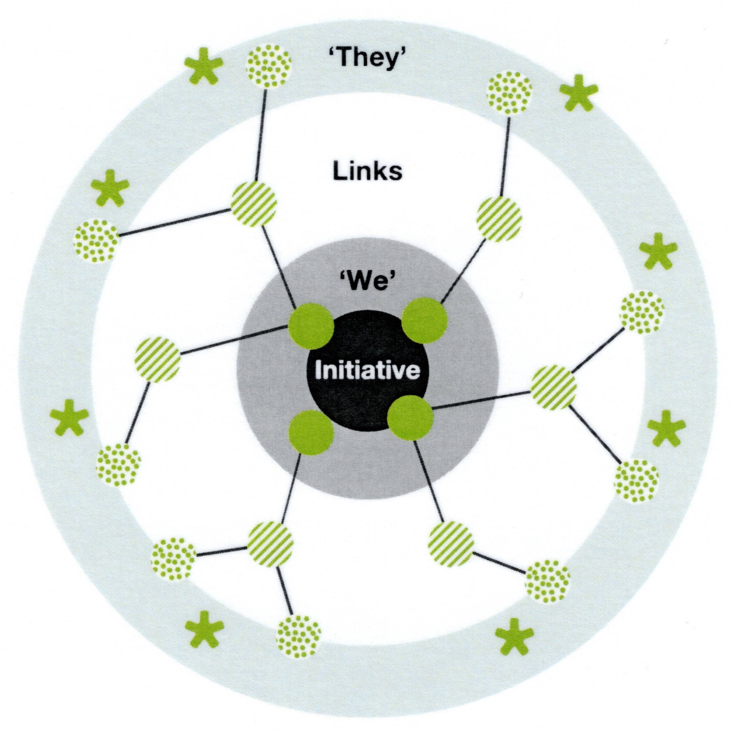
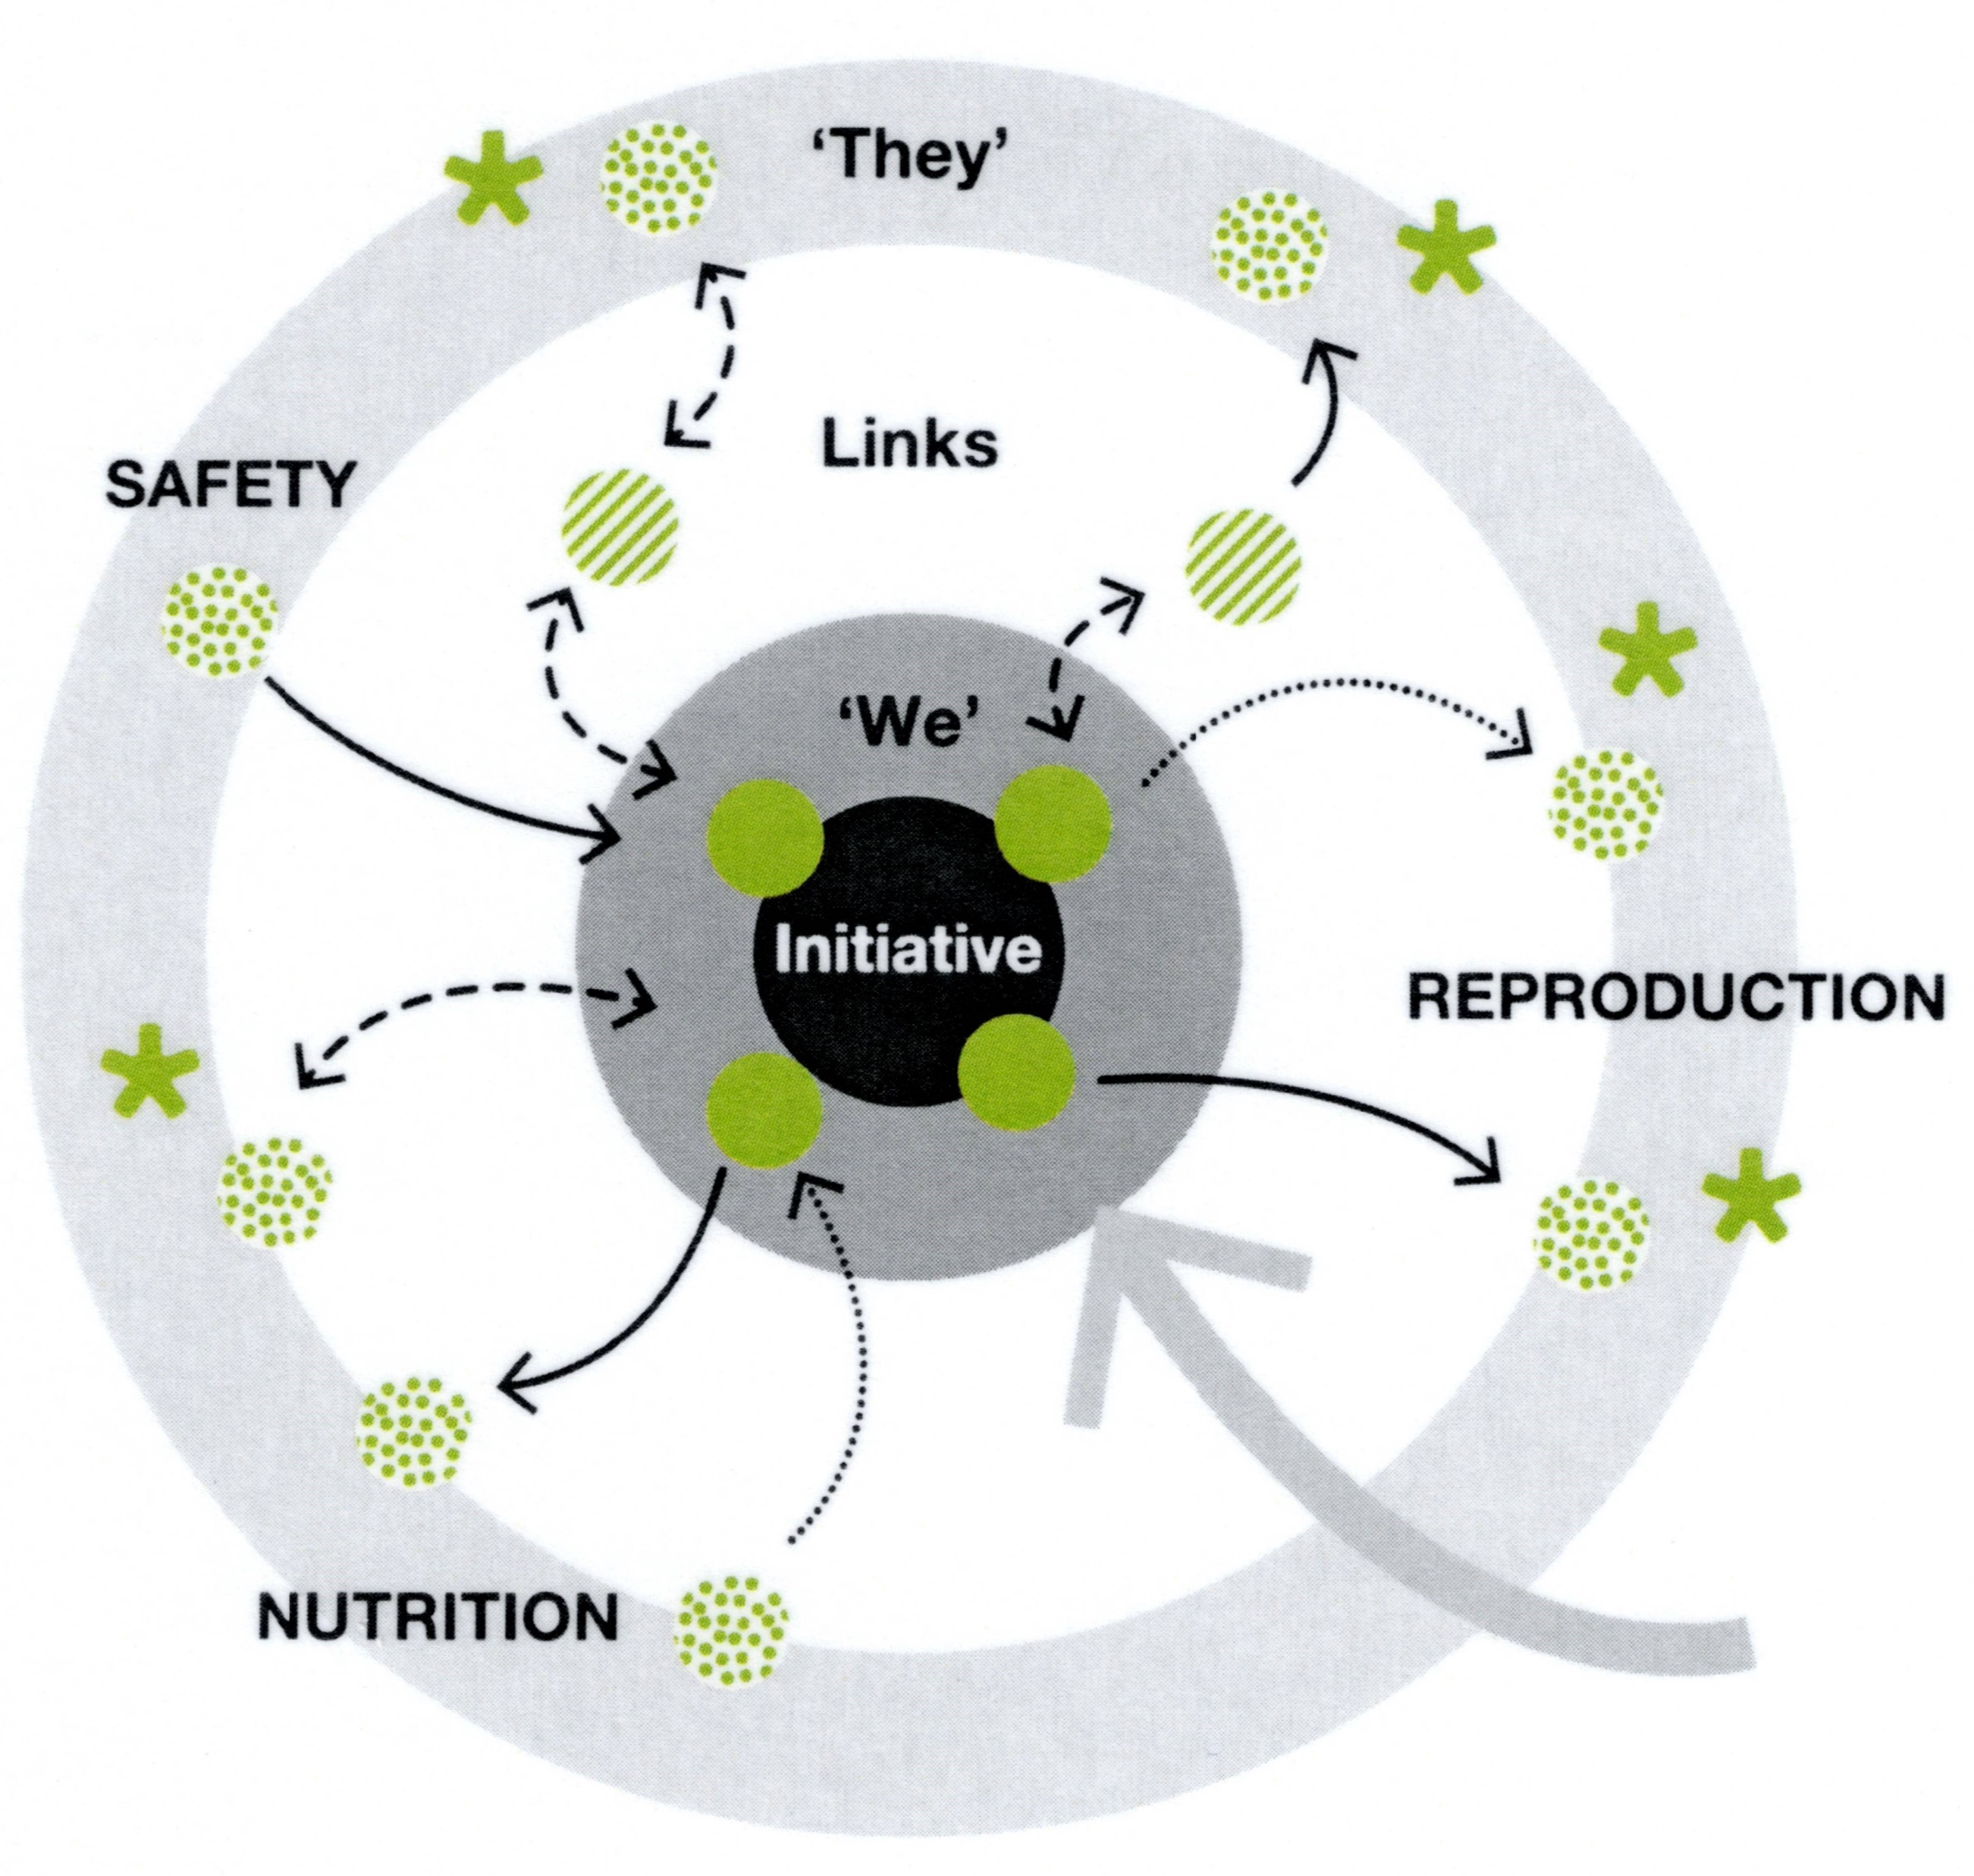
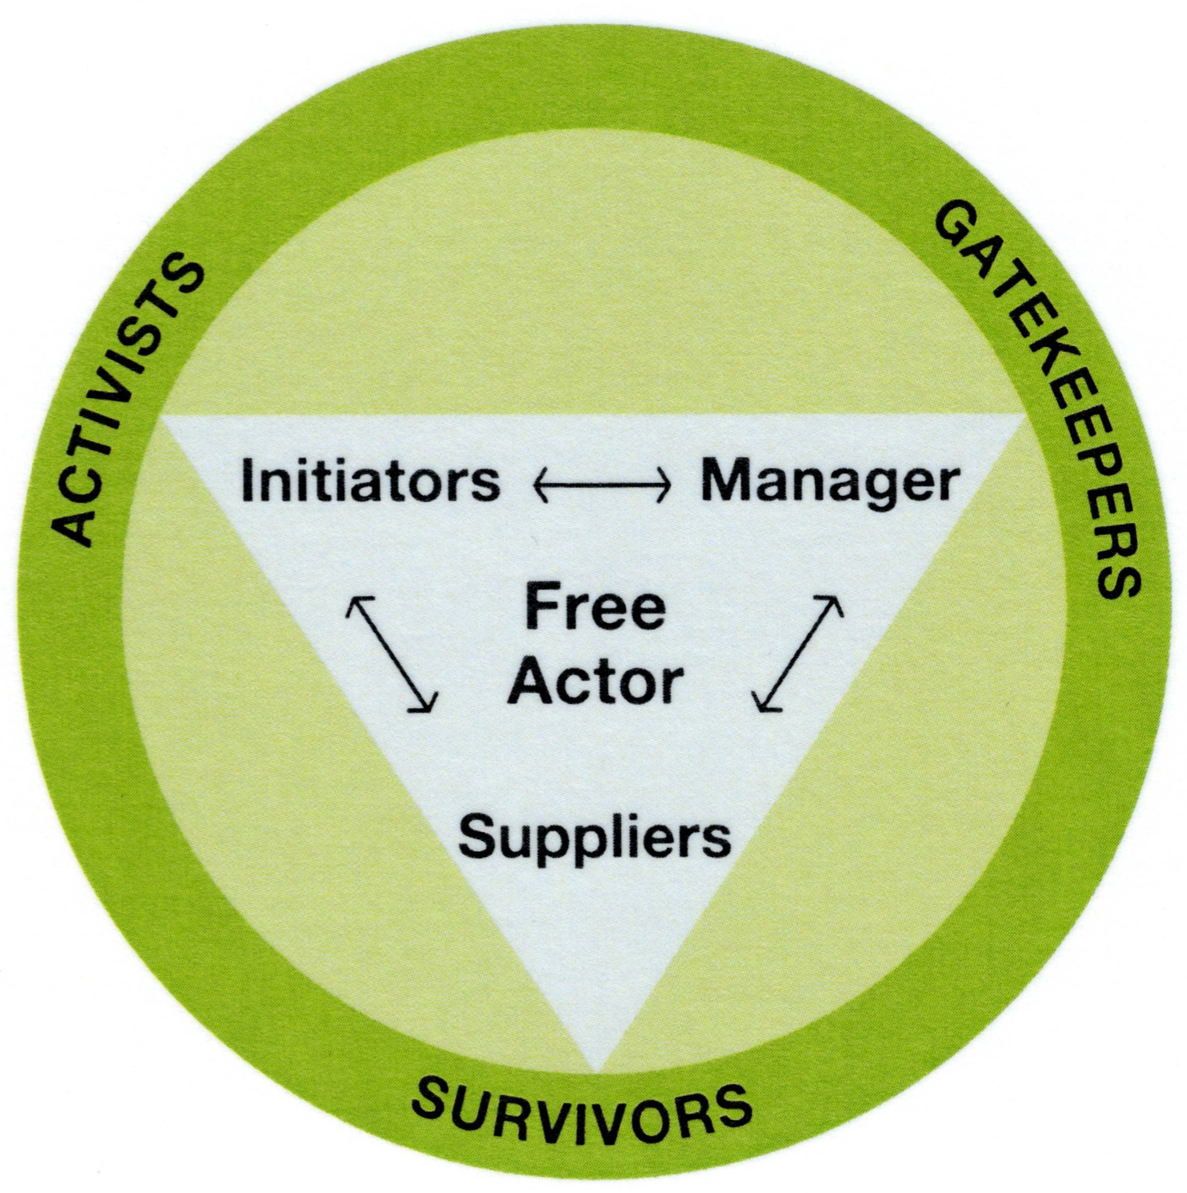
Tools for diagnosis
Vital
Space
Recognise patterns
Innovation processes are unpredictable, as they are part of complex systems.
Yet, there are certain patterns that frequently occur.
The analysis tools have been designed to recognise those patterns, to understand the logic behind them, and to see options to act effectively in the situation.
The Innovation Spiral
The Circle of Coherence
Development of the content:
from idea to realisation and further.
The Network Analysis
The Eco Analysis
Analysis of interaction patterns:
how to feed energy in the network?
Analysis of involvement of actors:
whom to connect with, how and when?
Analysis of quality of relationships: What to do to create a healthy human ecosystem?
The Triangle of Co-Creation
Analysis of positions: how to create complementary positions for co-creation?

Slide 38
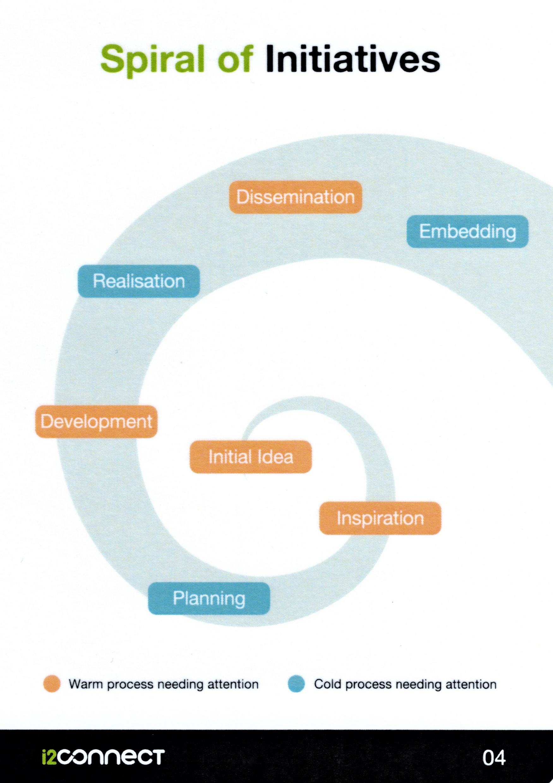
The Spiral of Innovations
Innovation processes follow a curly road, rather than a straight line from idea to realisation.
The Spiral distinguishes seven phases with different:
Key actions to be taken
Actors to involve
Typical pitfalls to avoid
The Spiral helps you to analyse where you are in the process and what needs to be done to enter the following phase.
Warm phases usually generate energy, while cold phases usually cost energy.
What is the warm and the cold process?
The original model is presented here:
the Spiral of Innovations.
It can equally be referred to as:
the Spiral of Initiatives, because the same mechanisms work for any initiative for change.
Further reading: Wielinga and Robijn 2020: Energising Networks p.84

Slide 39
What can we learn from and with each other?
Progress is made when people are really curious for what they can learn from others, and welcome new learning experiences.
You can stimulate that people listen to each other, take risks and allow for failure.
As soon as the other patterns no longer call for attention, the pattern of dialogue will emerge.
What’s in it for me?
If the balance between give and take is positive, people become more collaborative, and the benefits increase.
You can stimulate that people find ambitions they share, and make sure that the costs and benefits are shared in a satisfactory manner.
Similarities
The Circle of Coherence
If there is VITAL SPACE in a network if you feel free to do what you want to do in relation to others. You feel meaningful and safe. There is space for curiosity and creativity. You dare to try out, to fail and to learn.
Vital space is energising.
dialogue
exchange
WE
vital
space
ME
What can you do to increase vital space?
structure
challenge
1
Enhance constructive interaction patterns
2
What are our rules and tasks?
People need clarity about who takes responsibility for which tasks, and about procedures and rules in order to streamline the collaboration.
You can stimulate that people agree on Who, What, When, How and Why.
Can we disagree?
People need to know if their qualities are being acknowledged, and if the collaboration is strong enough to allow for disagreements.
You can stimulate that people challenge each other in a respectful manner, and thus discover strengths and weaknesses.
Differences
3
Frequently asked questions
Further reading: Wielinga and Robijn 2020: Energising Networks p.129

Slide 40
We agree too much
People feel safe and protected by the network, and don’t allow for critics and dissonant views. This limits the space for experimenting, learning and growth.
They need a shake up in order to allow space for what most of them feel by intuition but do not dare to express.
You can make provocations in a humorous but respectful way. You act as a joker.
I withdraw
If the balance between give and take is negative, people diminish their efforts or withdraw. Or refuse to join in the first place.
They need inspiration for making a different choice.
You can make connection between their ambitions and the aim of the network, and show the possible benefits. You act as an inspirator.
Similarities
The Circle of Coherence
People always balance between hope and fear:
Hope that collaboration will bring benefit, meaningfulness and protection.
Fear that collaboration will lead to loss of autonomy and abuse of trust.
FLOCK
FLEE
If fear outweighs hope, defensive patterns take over. What can you do?
WE
vital
space
ME
1
Enhance constructive interaction patterns
FREEZE
FIGHT
I fight for my position
People disagree and fight to have it their way.
They need recognition for what is important to them before there is room for negotiation about how to attune within the network.
You can give recognition and explore possible solutions that do justice to each party in the fight. You act as a mediator.
2
I don’t dare to move
People disagree, but taking action for improvement is too dangerous.
Both underdog and dominating party are stuck in a pattern of fear. They need safety.
You can create a safe space for experiments at a scale that is acceptable for all parties in the network. In leading these experiments, you act as a researcher.
Reduce need for defensive interaction patterns
3
Differences
Frequently asked questions
Further reading: Wielinga and Robijn 2020: Energising Networks p.129

Slide 41
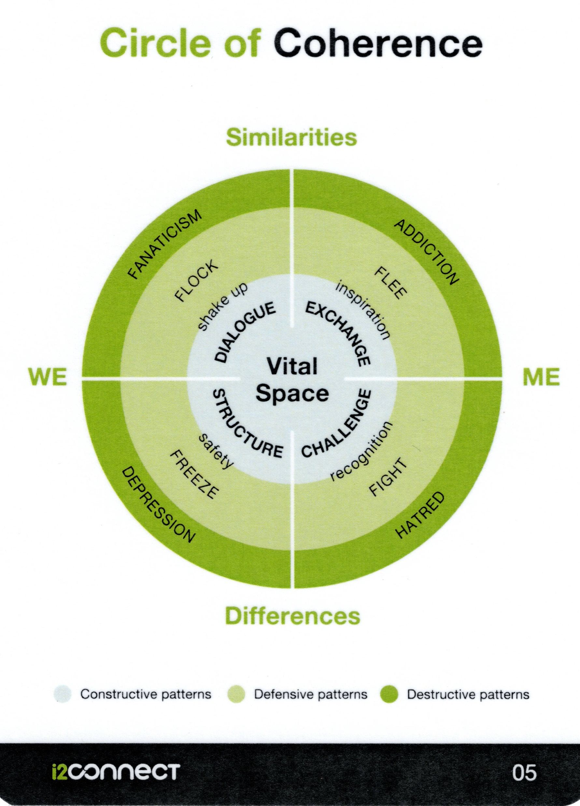
Only one truth.
It is unsafe to think and act beyond the lines. This makes dialogue impossible and joking dangerous.
If you have authority in the eyes of the network, you can act as a prophet, telling people that they are on a wrong and harmful track.
If you do not have that authority (which is most likely), you have to find one who is accessible for reason.
When fanaticism leads to violence, see the patterns of fight and hatred.
Shortcut to instant satisfaction
People act in an ego-centered way at the cost of the healthiness of both the individual and the community.
They are not accessible for inspiration in the illusion that they are better off on their own, and they are blind for the effect on others.
Harmful behaviour must be made impossible. You can impose the rules as a regulator.
When shortcuts no longer work, people have to connect again.
The Circle of Coherence
People always balance between hope and fear:
Hope that collaboration will bring benefit, meaningfulness and protection.
Fear that collaboration will lead to loss of autonomy and abuse of trust.
If fear outweighs hope, defensive patterns take over. What can you do?
1
Enhance constructive interaction patterns
Hopelessness
People give up hope, and lack energy for any positive action. Cynicism defuses any effort for changing the unwanted situation.
They need to experience that something positive can happen upon their actions. As an activist you can force a rearrangement of positions.
Once the needs of the underdog cannot be ignored any longer, there is space for researchers to create experiments with consent of parties involved.
Destructive drive
Aggression deforms into the drive to destroy. People believe that they are only safe when the enemy has been eliminated.
The escalating fight needs to be stopped by a third party: You can intervene with power as a strategist.
Only when actors see that winning is no longer an option, and the path of destruction only brings victims, there is an opening for negotiations and reconnection.
2
Reduce need for defensive interaction patterns
3
Stop destructive interaction patterns
Further reading: Wielinga and Robijn 2020: Energising Networks p.129
Frequently asked questions

Slide 42
The Circle of Coherence
Frequently asked questions
Similarities
The Circle of Coherence is a powerful tool, but also quite complex: it has many layers. The more you work with it, the more insights you will gain.
Understanding the Circle
Using the Circle
What is coherence?
When do I use the circle?
What is vital?
How can I analyse a case by using the circle?
What is energy?
WE
ME
How do I choose an intervention?
What is influence? And what is power?
How can I notice that I am on the right track?
What is an intervention?
What are warm and cold interventions?
Who intervenes?
What is the ultimate goal?
Is any network worth to be continued?
Differences
What legitimises my interventions?
What if things become really nasty?
Does negative energy exist?
Further reading: Wielinga and Robijn 2020: Energising Networks p.129

Slide 43
The Network Analysis
The Network Analysis helps to analyse which actors are needed to make change possible, and to what degree they are involved.
This analysis leads to set priorities for working on improving relationships.
People first
Institutions and positions of power play a role in any innovation process. But people are not equal to the institutions they represent.
The network analysis seeks opportunities to build warm networks between people who eventually can make things move from the inside.
It is therefore important to identify persons instead of institutions. These persons might be interesting for the initiative because of the position they have within their institutions.
Things will move when formal decisions are being taken after the cold process. But prior to this, the warm process needs to take place for making a chance for success.
“they”
Initiative
What is the shared ambition of the “We” network?
links
Carriers
Which persons feel responsible for bringing the initiative further?
“we”
Factors
Which factors could determine success?
Actors
Who needs to move? Which actors have influence over the key factors?
initiative
Links
Which persons are approachable for carriers to make connection to these actors?
How to use the Network Analysis?
Take a large flipchart or wall paper.
Use Post-Its or carton cards in the colours as indicated above.
Fill in the cards following the questions, and place them on the flipchart as indicated in the picture.
Discuss who can approach which links in the near future.
Source: Adapted from Poorthuis, A.M., Bijl, C. van der (2006): “Van netwerkanalyse naar organisatieroutine” [from network analysis to organisational routine]. In: Poorthuis, A.M. (red) (2006): De kracht van netwerkbenadering. [The power of network approaches]. Assen: Van Gorcum.

Slide 44
The Eco Analysis
The Eco Analysis is an extension of the Network Analysis, and analyses the quality of the relationships. This allows for assessing in more detail what it takes to move towards collaborative relations.
Five types of relationships
In ecosystems, organisms relate to each other in different ways. Relations can be symbiotic or destructive for at least one party.
“they”
Partner:: There is balance between give and take. Symbiosis: both partners profit.
Predator – Prey: There is unbalance between give and take. Predator profits at the cost of the prey.
Parasite: Breaks in and causes disease.
Plague: Overwhelms and destroys.
Basic Needs
All living creatures have three basic needs: safety, nutrition and reproduction. This is also true for initiative networks.
Safety: Some factors can provide safety to the “We” network” of initiators (e.g. project management), while others might be threatening (concurrence).
Nutrition: All resources needed for the initiative (e.g. expertise, information, money, human power, etc.)
Reproduction: This is the contribution to the world when the initiative yields success. What will become visible? And how will the movement carry on?
links
safety
“we”
How to deal with threats?
The challenge is to curb relationships towards complementarity.
Dealing with partners: cherish good relationships, and keep on investing in vitality.
Dealing with predators: gain strength and negotiate for mutual gain.
Dealing with preys: bring balance in give and take for a long lasting relationship.
Dealing with Parasites: fix the hole in your defence, and find out what these actors are telling you from a systems perspective.
Dealing with Plagues: seek rescue in your warm network, and make yourself ready for new opportunities that will emerge.
initiative
reproduction
Questions for analysing a case using the Eco Analysis
After defining the factors the Network Analysis, put together what belongs to safety, nutrition and reproduction. You can also mark the Post-Its with S+, S-, N and/or R.
Which needs are well represented?
Which ones are poorly served?
Could you add factors to complete the picture?
nutrition
Source: Wijffels and Wielinga 2018 (unpublished)

Slide 45
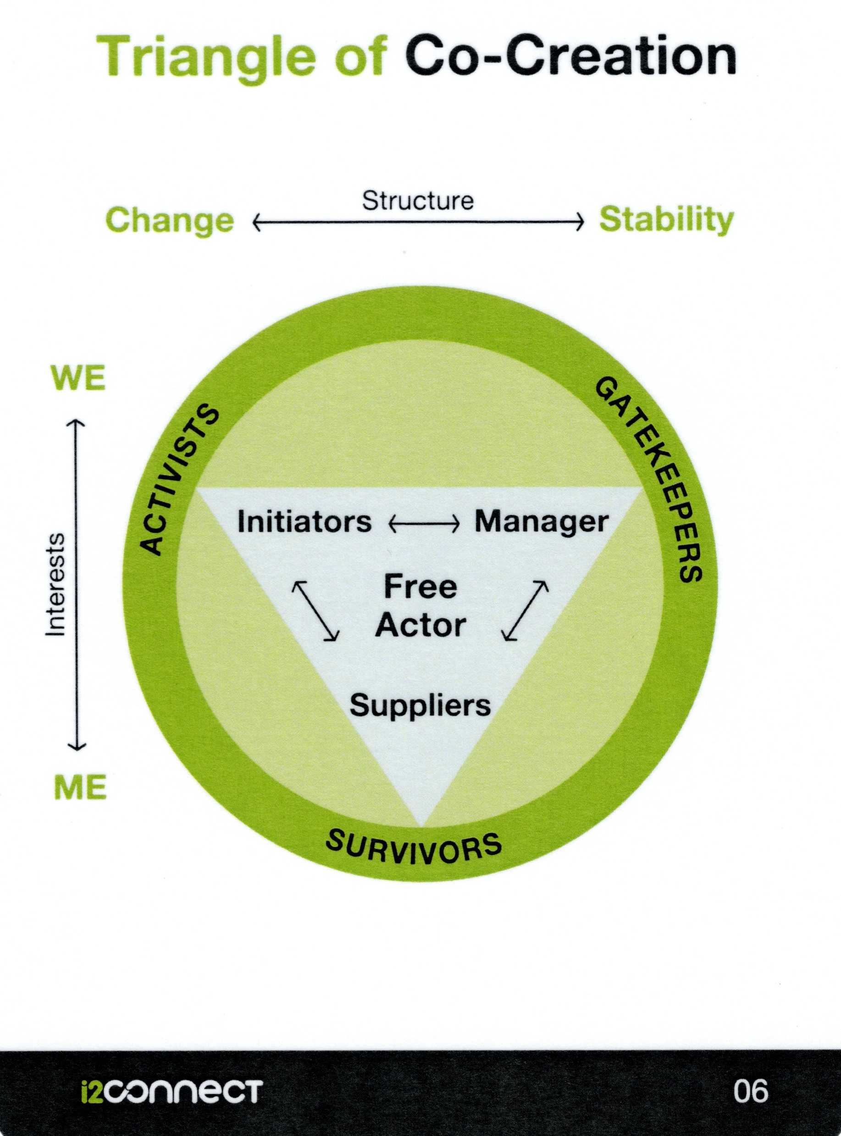
FUNCTION: What someone is supposed to do within a structure (e.g. advisor, manager, entrepreneur, policy officer).
ROLE: What someone tries to do in relation to the network.
POSITION: What someone does in reality in the perception of others in the network.
Someone can have the function of manager, try to perform as an initiator, but end up as a survivor when things do not work out well.
The position of a Free Actor needs to be acquired.
The Triangle of Co-Creation helps to analyse how actors position themselves in the process, and how they can be stimulated to contribute.
Positions that contribute to co-creation
Co-creation requires contributions from actors in complementary positions. Initiators: “We want to make things change”
They feel the ambition for change and go for it. Their energy can be contagious.
Managers: “What can we do to make it possible?”
They feel responsible for the structure as it is and have the power to change it.
Suppliers: “What can we contribute within our mandate?”
They contribute within the limits of the structure.
Questions for analysing a case using the Triangle
The perception of the storyteller is leading.
[1] Who are key actors in this case?
[2] What positions do these actors take in the Triangle?
[3] Are the four positions within the Triangle taken? If not, which one is vacant?
[4] For each actor outside the Triangle: why do you think (s)he takes this position?
Keep in mind that actors can have good and legitimate reasons for staying outside.
[5] What would (s)he need before moving towards a contributing position?
[6] Who can take action to take away barriers?
Positions that do not contribute to co-creation
Actors in positions outside the vital space do not contribute:
Gatekeepers: “This is not possible, because …”
They control structures and do not permit change.
Survivors: “We just have to survive”.
They don’t have space to run risks.
Activists: “We want change, whatever it takes”.
They seek change but don’t care about the structure.
Strategy
<a> Create a warm network of actors who sympathise with the ambition of the initiator(s).
<b> Enter into dialogue with the managers in order to create space for experimenting and change.
<c> Invite suppliers to contribute, once the conditions allow for doing so.
Free Actors exercise their freedom to do whatever it takes to make and keep the network healthy and creative. Others appreciate them for doing so, even if they scribble outside the lines when necessary.
Further reading: Wielinga and Robijn 2020: Energising Networks p.181.

Slide 46
The Contract Triangle
Manager
Three positions in an advisory activity
  Manager:
  The manager controls the conditions under which the advisor does his/her work. This can be the team leader, the employer, or the agency that pays for a project or programme within which the advisor operates.
  Client:
  The client receives a service from the advisor. This can be an advise, guidance in certain activities, assistance in linking the client to other actors, etc.
  The advisor:
  The advisor provides services to clients (e.g. farmers, producers, etc.)
Different contractual relations
An advisor is always functioning in a field with different contractual relationships:
  Contract of work:
  This is the mandate within which the advisor does his/her work. Probably he/she has a task- or job description, or maybe a Terms of Reference if he/she is contracted for a specific job in a project.
  Contract of business:
  These are the conditions for the transaction between advisor and client. Costs or cost calculation. Time and period. What happens if things deviate from plan?
  Contract of objectives:
  What does the client expect from the advisor? For what question does (s)he seek assistance? When will the client be satisfied?
Contract of business
Conditions of transaction
(payment, duration, sanctions, etc.)
Contract of work
Task description
Terms of Reference (TOR)
Mission
Client
Advisor
Contract of objectives
What do you expect from me?
Courtesy: Idèle, France: Christèle Couzy

Slide 47
The Facilitation Triangle
Travel agent
‘We make it easy for you’
Facilitation is a serving activity
The network (client, operational group, etc.) formulates its ambitions and wishes which are leading, even though these might change in the course of the process. This is the mandate within which the facilitator is invited to assist.
The facilitator serves the network. In the terminology of the Triangle of Co-creation, facilitators are suppliers.
The Facilitation Triangle shows different ways in which this serving role can be performed.
Moderators provide structure for the process: they make agenda’s and time tables, bring in methods for exchange and discussion, lead meetings, etc.
Animators stimulate people in the network to become involved and active. They focus on enthusiasm and removing barriers for collaboration. They boost energy.
Facilitators make it easy for people in the network to participate and to give their contributions. They do whatever is needed for allowing participants to concentrate of the contents of their joint endeavour. They act like the travel agency that ensures that their clients can enjoy without any worries.
facilitation
In practice facilitators will do things that belong to each of the corners.
Useful questions for facilitators:
Where would you place yourself in the triangle I you just follow your personal preference?
What is needed most at this moment in the network you are serving?
What actions can you take to improve the performance of your network?
animation
moderation
‘We stimulate the flow’
‘We provide structure’
Booster
Traffic controller
Courtesy: xxx

Slide 48
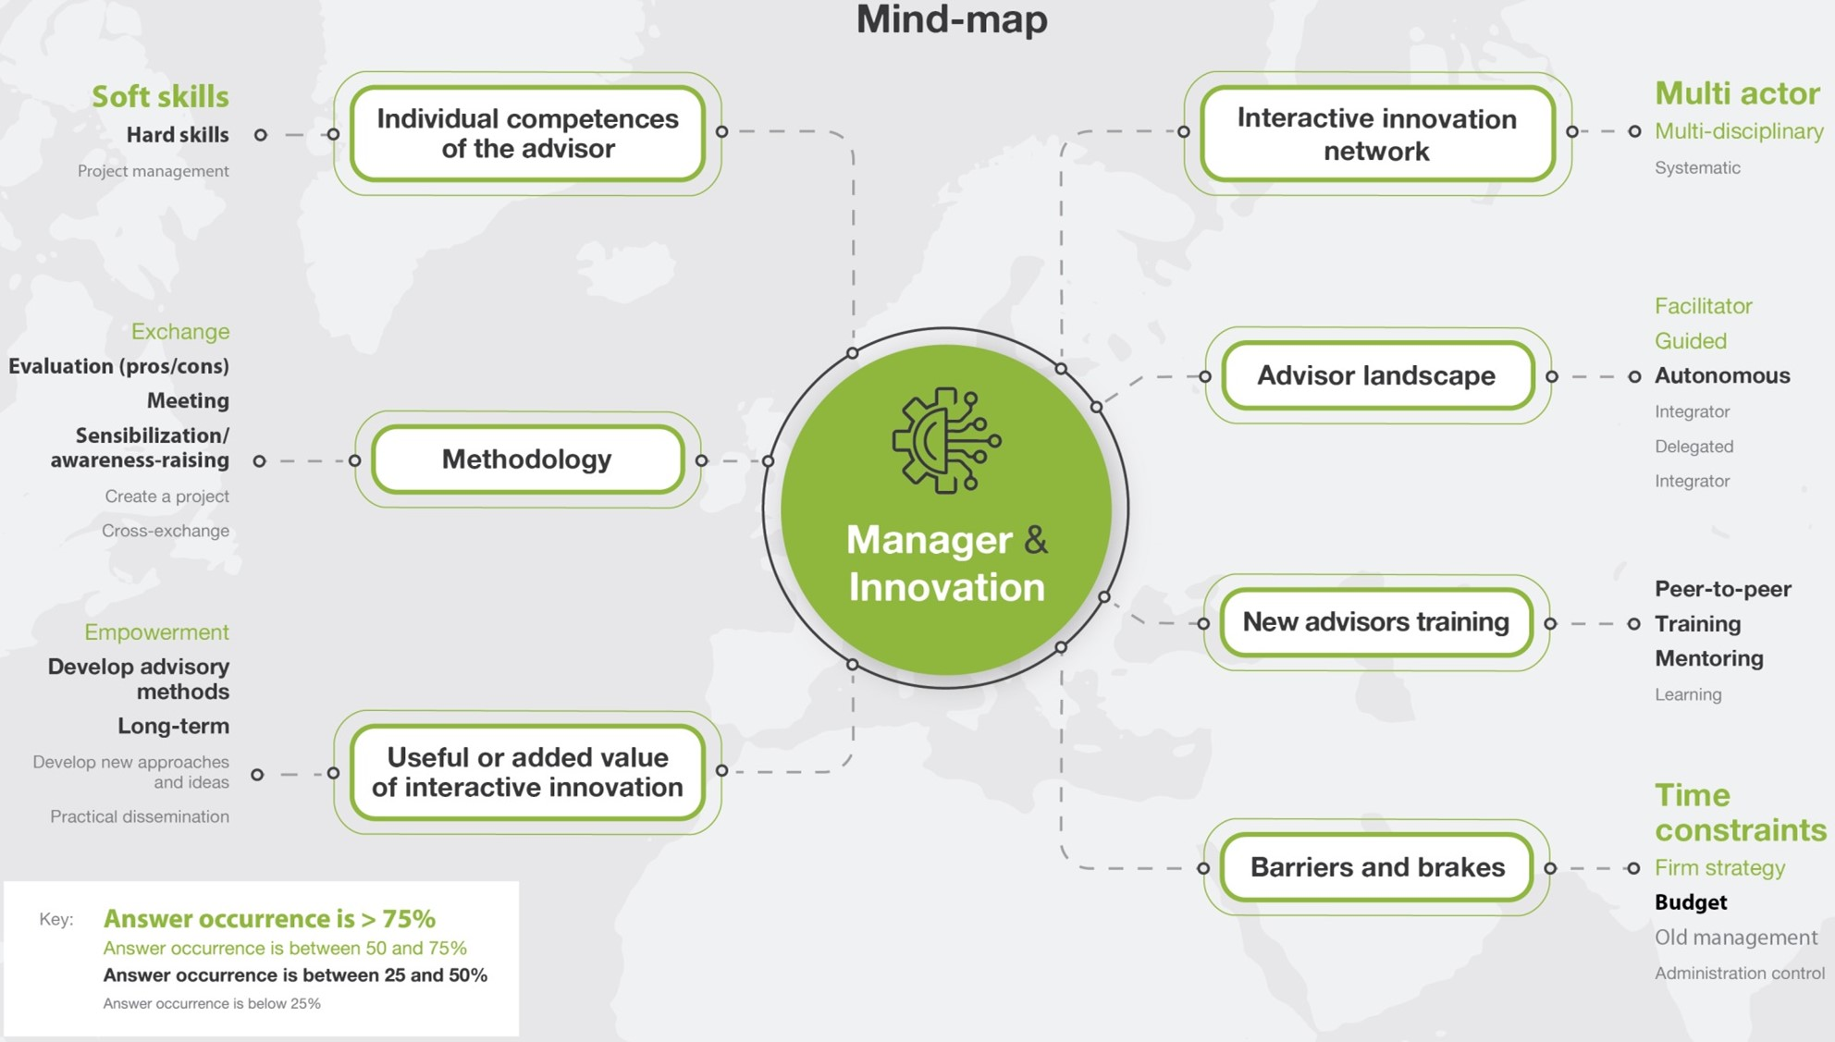
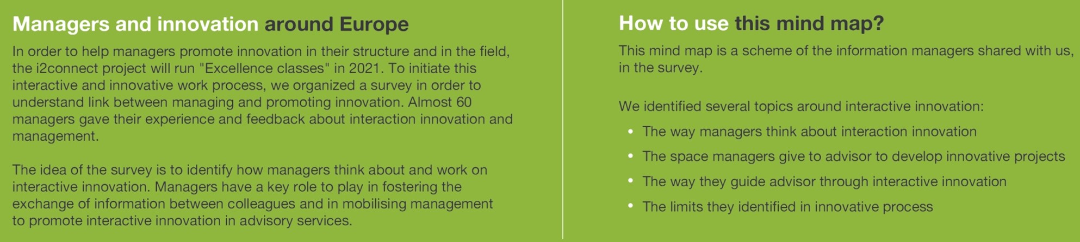
Management aspects
regarding interactive innovation

Slide 49
Reflection
Become a reflective project partner
It is helpful to ask yourself some specific questions after each event or experience. Below you find a template for doing so.
In the i2connect project we wish to learn from and with each other. Therefore it is important to share our learnings. So, please log in and write your reflections in the on-line tool. In WP1 all contributions are processed into our collective learnings.
Here is where you find the form.
Not yet registered? Here is where you can do so.
Please note that your reflections will be anonymous. Feel free to write whatever you think that matters.
Take intuition seriously.
Most things we do in connection to others, we do by intuition. Many of those things are the right things to do, although we are hardly aware of what we do. Sometimes we unconsciously apply strategies that are not so effective.
Reflection helps to become more aware of how we have acted in a certain case, and how we could be more effective next time.
https://i2connect.aidaform.com/reflection-template
https://i2connect.aidaform.com/becoming-a-reflective-project-partner-signup-form
Take time for reflection.
Time for reflection is usually the first victim when we are busy. Keep a diary. Make it a habit after each event to write some reflections. Make time free in your agenda. The best is to schedule time to reflect together with peers.
I2connect offers an online tool to capture your experiences.
The reflection template
Your user ID
What is the event or occasion to which your reflection is related?
What are your observations and learning insights on ‘interactive innovation’ and/or ‘the innovation advisor’?
Which of these insights would you like to discuss with others in i2connect?
What conclusions do you draw from your insights for a next event within i2connect?
What conclusions do you draw from your insights for your own professional work (e.g. in terms of concrete actions)?
Any other comments:
Tools for reflection.
The tools are designed to recognise patterns, and to consider options to act.
Peer-to-peer consultation.
In a trusted environment, colleagues probably see more that what you were aware of. This can be very helpful.
It takes time to do so. Schedule it in your agenda.
Guideline for peer-to-peer consultation.
The guideline takes you step by step through a procedure for analysing a case.
For any questions or suggestions: contact Sangeun Bae:
s.bae@uni-hohenheim.de

Slide 50
Guideline for peer coaching.
The storyteller brings in the case. (S)he has a question on which (s)he would like to hear the ideas of colleagues.
Coaching for peers (1)
1
Distribute and clarify roles.
Storyteller
Advisor(s)
Moderator
The colleagues assume the role of advisor. They try to understand the case and the question, and share ideas in which answers might be found.
This simple and effective method helps a storyteller to study a case together with colleagues.
Such coaching between peers allows for sharing resources and competences of all, and enhances the the group spirit.
Clarification.
The storyteller explains the case and the question for which (s)he seeks an answer.
Situation, context
The challenge
The question to the peers
The peers listen carefully, make notes, and ask clarifying questions.
The moderator chairs the meeting, makes sure that the steps are followed properly and stimulates active participation of all.
2
Take intuition seriously.
Most things we do in connection to others, we do by intuition. Many of those things are the right things to do, although we are hardly aware of what we do. Sometimes we unconsciously apply strategies that are not so effective.
Reflection helps to become more aware of how we have acted in a certain case, and how we could be more effective next time.
Discussion between peers. (‘to gossip’)
The peers discuss the case, with the question in mind. How can be understood what is happening? It is not to idea to find the ideal answer, but rather to explore different angles to understand the case. For example:
What attracted my attention, both in contents and in the way it was explained?
What questions and suspense came to my mind?
Which approaches appeared to be successful in similar cases?
What else could be observed?
The storyteller listens, but does not join the discussion, unless the peers completely misunderstand the situation.
3
Take time for reflection.
Reflection helps to become more aware of how we have acted in a certain case, and how we could be more effective next time.
Peer-to-peer consultation.
In a trusted environment, colleagues probably see more that what you were aware of. This can be very helpful.
It takes time to do so. Schedule it in your agenda.
Taking position.
The storyteller tells what (s)he will do what (s)he has heard.
What inspired me? What convinced me?
What am I doing to do concretely? What are my first steps? When, with whom, where and how?
What questions would I like to ask for a deeper understanding?
This last question could bring the team back to phase 2 if there still is time.
4
Wrapping up.
Analysis of the coaching process by all who have participated. What lessons can be drawn individually:
Everyone for his/her own practice: what did I learn?
For the next coaching session: what became clear in this method, what could be improved?
There is not just one best method for peer-to-peer coaching. Try different methods and make your own blend.
5
AGRIDEA - 10.05.2019/Korac Sanela/10-Coaching Entre Pairs-15-02-24-Mvu.Docx

Slide 51
Guideline for peer-to-peer consultation.
Coaching for peers (2)
Peer-to-peer consultation
This guideline stimulates analysis of a story by making use of the network tools.
Starting up. Ask participants on what issues they whish to consult the others. Allocate the available time. Start with the issue that attracts most attention.
Prevent too much explanation. There is room for clarification in step 2.
1
Formulating the question. The storyteller explains just enough for others to have some understanding of the issue.
Prevent discussion. If someone disagrees with the question of one other, (s)he should formulate his/her own.
2
Clarification. The participants ask questions for clarification, and the storyteller gives answers. This goes on until participants think they can start the analysis.
There is a strong temptation to give advices or judgements. Don’t do it before step 5!
3
Analysis. Choose a tool and reframe the situation in this language. What does it make you understand about what is happening?
This is the moment to make use of one of the tools. Make a choice of the tool that fits best.
Take time for reflection.
Reflection helps to become more aware of how we have acted in a certain case, and how we could be more effective next time.
4
At this stage the question is usually much clearer than at the start. It is important that the storyteller rephrases it him/herself.
Reformulating the question. The storyteller rephrases the question for which (s)he likes to hear suggestions.
Peer-to-peer consultation.
In a trusted environment, colleagues probably see more that what you were aware of. This can be very helpful.
It takes time to do so. Schedule it in your agenda.
5
Advice. The participants tell what they would do if they were in the position of the storyteller.
Prevent discussion. If someone disagrees with the advice of one other, (s)he should formulate his/her own.
Tools for reflection.
The tools are designed to recognise patterns, and to consider options to act.
6
Conclusions. The storyteller tells what advices are most useful to him/her, and why.
There are no right or wrong answers. What works for one might not be a solution for another. Only the storyteller can judge what fits him/her best.
Guideline for peer-to-peer consultation.
The guideline takes you step by step through a procedure for analysing a case.
Wrapping up. Each participant shares with the others what (s)he takes along from this consultation.
If applicable, a new appointment is set.
There is not just one best method for peer-to-peer coaching. Try different methods and make your own blend.

Slide 52
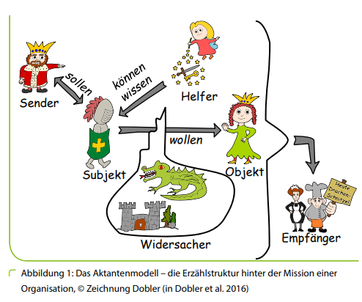
The journey of the hero
An interesting story is like the journey of the hero (m/f):
He goes on his way with an ambition or mission.
He might find friends willing to join.
He encounters unexpected barriers or challenges.
His equipment is not suitable, his assumptions were not correct.
Friends might not cope with the situation and leave him.
When all seems hopeless there is help from an unexpected corner.
While fighting the dragon he gets a hunch and becomes creative.
He wins, and ends up in a much better situation than what he aimed for.
Story telling
Stories for learning together
There are many ways to tell stories and to write them down.
A story becomes useful for peer-to-peer learning if it talks about experiences where the main character met a challenge and acted upon it.
The most interesting stories are those in which you tell about your own experience.
Key elements of a story
Initial situation: why did you come into action?
Ambition: what did you want to achieve?
Action: how did you start?
Events: what happened which explains the cliff-hanger moment?
Cliff-hanger moment: what was the moment that you had to decide on how to carry on?
Intervention: what did you do that changed the course of events?
Result: what is the new situation?
helper
know how
ambition
will
.
hero
subject
Tips
Keep it short. Just explain what is essential to understand why the cliff-hanger situation arose, what you did, and what effects you observed afterwards.
Keep room for clarifications. There is no need to be complete, because your peers will ask to clarify what they do not understand.
opponent
beneficiary
Drawing: with courtesy to Füak, Germany, Das Aktantenmodel

Slide 53
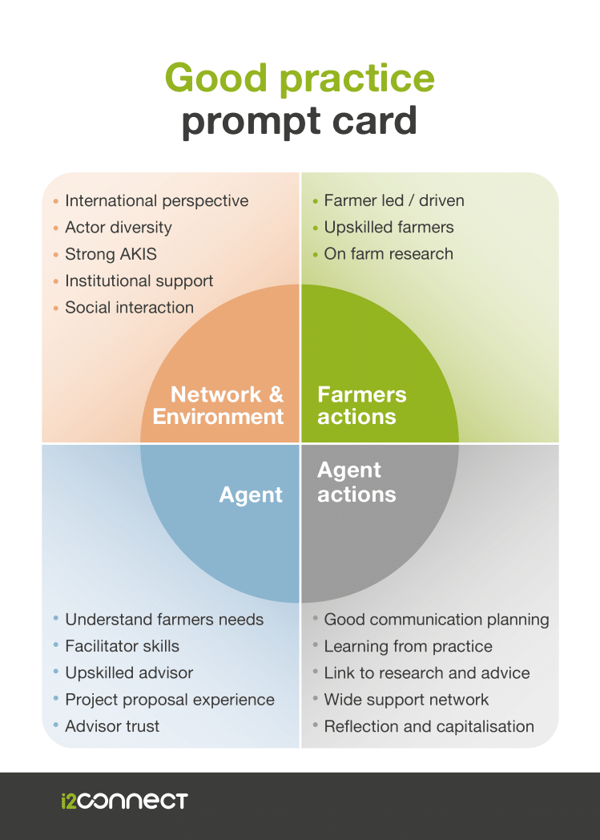
Reviewing Good Practices
Learning from good examples of interactive innovation
What are you looking for, when you are asked to review an interesting case of interactive innovation?
In Work Package 2 of the i2connect project more than 100 cases have been reviewed by international teams of peers. For guiding the observations, a template has been developed, which is summarised here.
How does it work?
The visiting team tries to find evidence for indicators that are supposed to contribute to the result of the efforts of the key actors in the case. These indicators are classified in four themes:
The network / the environment
The broker (advisor / innovation support agent)
Actions by the advisor (agent)
Actions by the farmer
Each theme is a window through which you look at a different part of the system in which the innovation takes place.
.
Combination with the Spiral of Innovations
For reconstructing the story of the case, from where it started and where people are now, this template can be combined with the 7 phases of the Spiral of Initiatives.
Origin: i2c - WP2 team

Slide 54
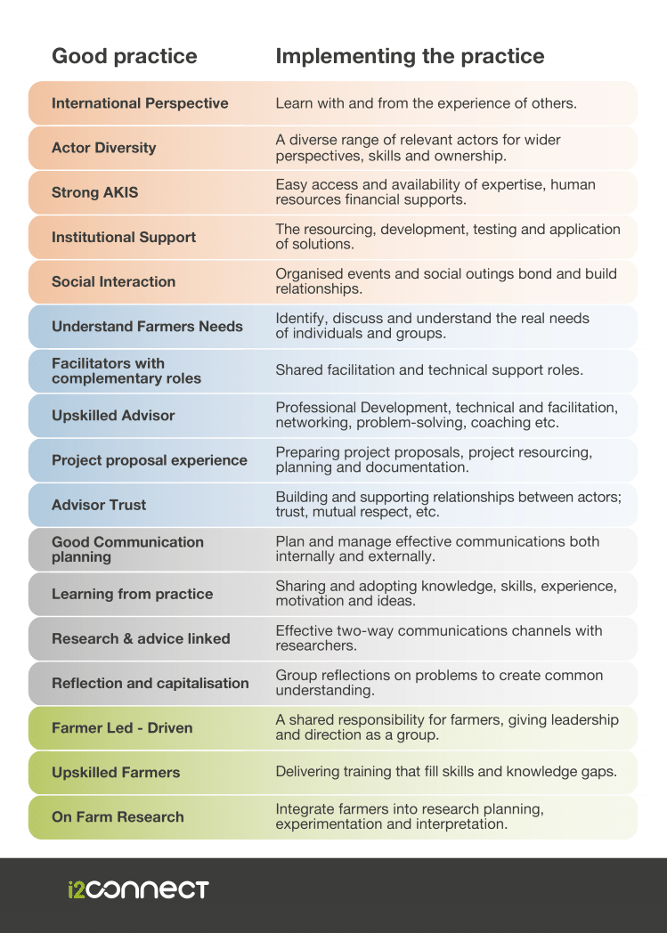
Reviewing Good Practices
.
Origin: i2c - WP2 team

Slide 55
The Energy Timeline
In this method the perception of the participants is leading. It is their process, and they build further on the outcomes of this session.
The energy timeline method is an easy-to-use method for joint evaluation in a network. It focusses on critical moments as perceived by the participants in the session.
Milestones
Procedure
1. Prepare the timeline
Prepare a large wallpaper. If you use flipcharts, the number depends on the number of participants: approx. 5 flipcharts for 10 participants.
Divide the wallpaper in three rows:
Upper row: moments that gave energy
Middle row: moments that took energy
Lower row: moments of new insights or opportunities
Vertical lines divide the timeline in periods with milestones that are recognisable for all. E.g. periods in time, important events or meetings.
2. Explain the purpose of the activity
3. Write sticky notes for every moment that matters
Ask all participants to write sticky notes for moments in the process they remember as significant. One note for each moment. Write with markers. Facilitators write notes too. Once ready, they stick them where they belong on the Timeline, in time (horizontal) and in energy (vertical).
4. Look at the general picture
What does the Timeline tell about the energy levels throughout the process? Is there a relation between difficult moments and breakthrough moments at the lower row?
5. Pay attention for details that need attention
Are there any cards that require explanation? Or opposing perceptions that are interesting to discuss?
6. Draw conclusions
What does this Timeline tell about the process the network has gone through? Does it lead to actions for the future?
The next step is made in the Learning History. Then the course of event is analysed by making use of available expertise and theory.
Sticky notes
Moments that take energy are not negative. These are opportunities to learn.
Insight moments often follow difficult periods
Sources:
Wielinga, H.E. et al. (2008): Networks with free actors: encouraging sustainable innovations in animal husbandry by using the FAN approach. Wageningen University and Research.
Wielinga, H.E. (2016): Dynamics of Living Networks. Syllabus CECRA 16 module.

Slide 56
The Learning History captures the lessons learned during a network process over a certain period of time. While the Timeline reflects the perceptions of participants, the Learning History adds analysis and conclusions, in terms of lessons learned and eventual future action.
Perceptions are non-negotiable: these are the ways participants have experienced things. Opinions may differ however on the way these perceptions should be understood, depending on the theory-in-use of the one analysing the story that results from the Timeline.
The value of the Learning History added to the Timeline is twofold: it makes analysis explicit and provides a relatively concise and easily readable account.
The Learning History
The Learning History combines observations and perceptions with an analysis, based on theory.
Procedure
1. Capture the narrative story
The Timeline method is very useful for doing so. Interviews can be used a well. The narrative has a structure like “… and then …, and then ….”. The narrative does not need to be complete, but it should contain the elements that matter most in the perception of the actors involved. About this narrative these actors should say: “Yes, so it happened, nothing important has been left out, and nothing has been added that we do not recognise.” If there are different perceptions about the same events, these are facts too that belong to the story.
2. Divide the story into scenes
3. Add newspaper headlines
x
4. Analyse the scenes
Ask all
5. Look at the history as a journey of the hero
What
6. Draw conclusions
What
A Learning History differs from other types of documentation about processes:
Scientific article:
This is what we add to science.
Popular article:
Look what we achieved, and what is possible.
Brochure:
This what we can do for you.
Pamphlet:
This is what needs to be done.
Report: This is how we spent the money.
Learning History: This is what we learned on our discovery journey.
A Learning History is short and interesting to read.
Sources:
Roth, G. A. Kleiner (1995). Learning Histories, a formal process for organizational learning. Systems Thinking: in Action Conference Proceedings, 18-20 September, Boston, MA, p. 195-206
Wielinga, H.E. (2016): Dynamics of Living Networks. Syllabus CECRA 16 module.

Slide 57


Feedback
If you give feedback to actors after having studied their case, here are some tips to keep in mind:
Pearls
Puzzles
Proposals
1. Avoid judgements
You have been around for a very short time only. Your analysis is based on a limited number of observations. Who are you to know better?
2. Seek balance in your observations
List things you appreciate (pearls) and things you are questioning (puzzles).
3. Wrap critics into puzzles
By doing so you might make people aware of things they did not see so far. But you also leave an opening for them to explain what you have not seen.
4. End up with proposals
If you were them, you would …..
You might also have proposals to take back home, for your colleagues or for yourself.

Slide 58
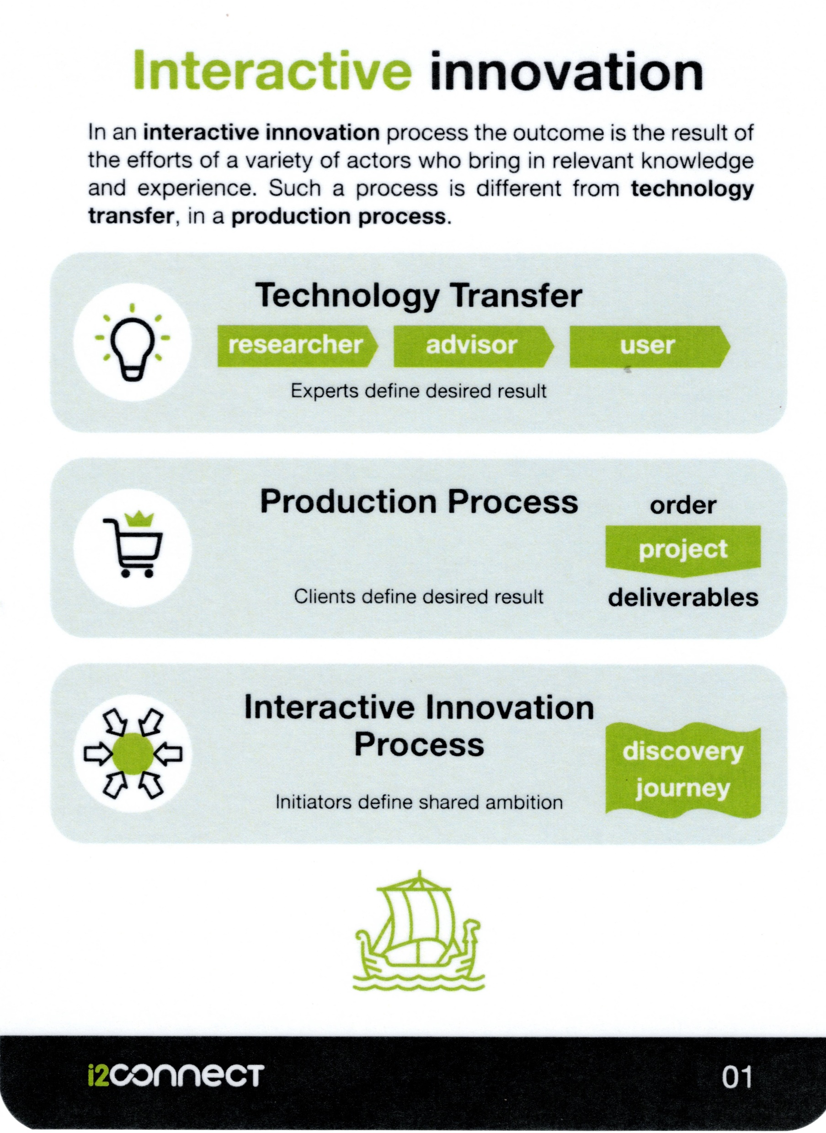
Feedback
Testing
Why avoiding judgements?
Interactive Innovation Processes require a different way of monitoring progress.
Consider this difference:
Transfer: The expert knows what the result should be.
Delivery: The client knows what product (s)he wants to get.
Co-creation: The result is not known beforehand, but the initiators had an ambition: the reason why they embarked on the journey.
A judgement is a comparison between what it should be and what it is in reality.
In transfer or delivery, what it should be is defined by the expert (transfer) or client (delivery). But in co-creation such a comparison is impossible. Instead, everything that takes energy is material to learn from.
Examination
Rating
Feedback on Satisfaction
Quality Control
Reflexive Monitoring
Energy Timeline
Learning History
Vitality Measurement Tool

Slide 59


